Slide 1
Electricity Coupled with the Heating and Transport Sector
Electricity Mismatch Analysis

Slide 2
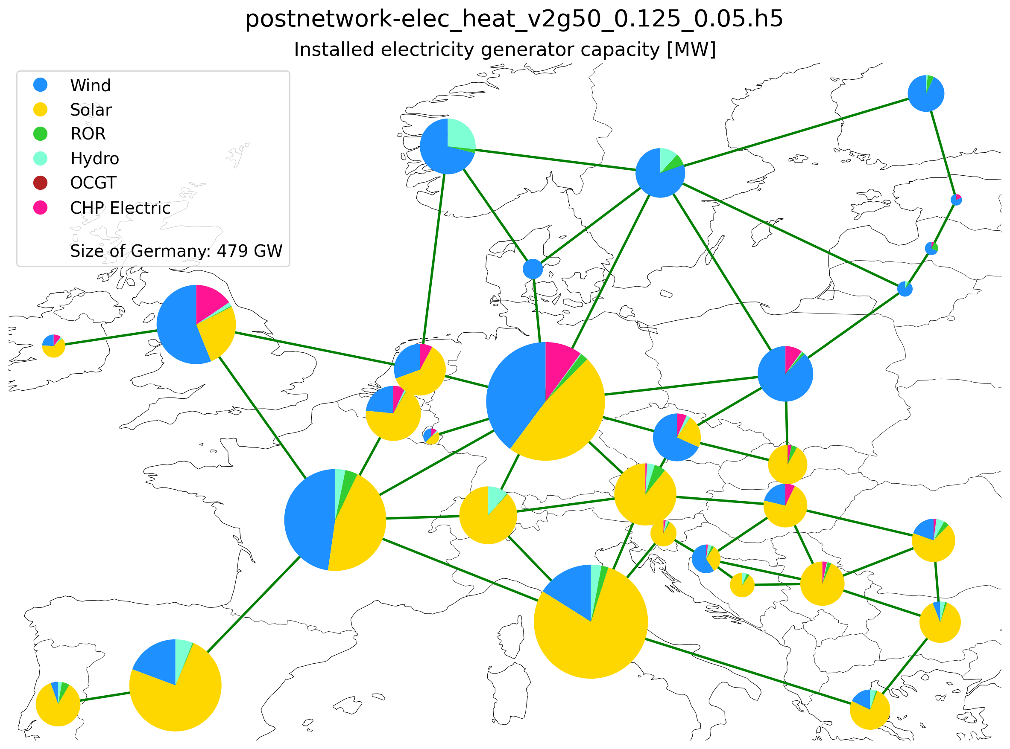
Installed capacity (95% CO2 reduction)

Slide 3
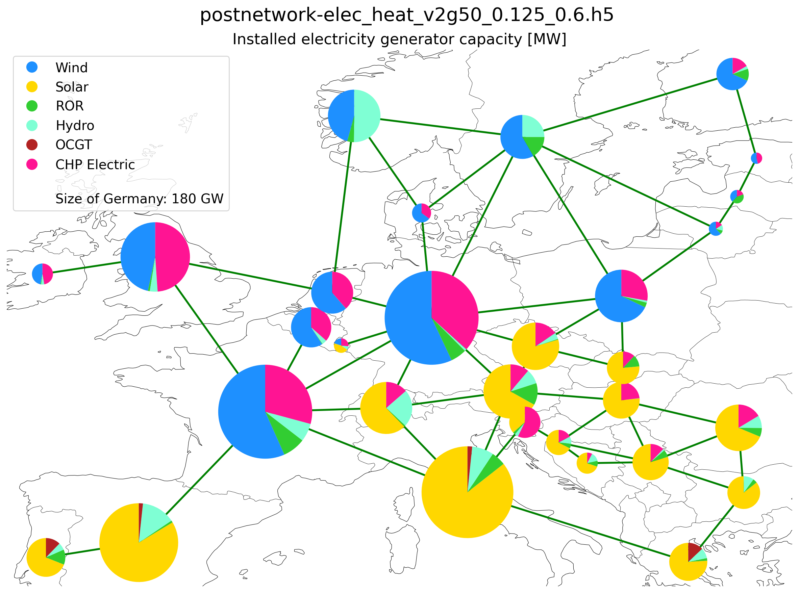

Installed capacity -
40% CO2 reduction
Installed capacity -
50% CO2 reduction

Slide 4
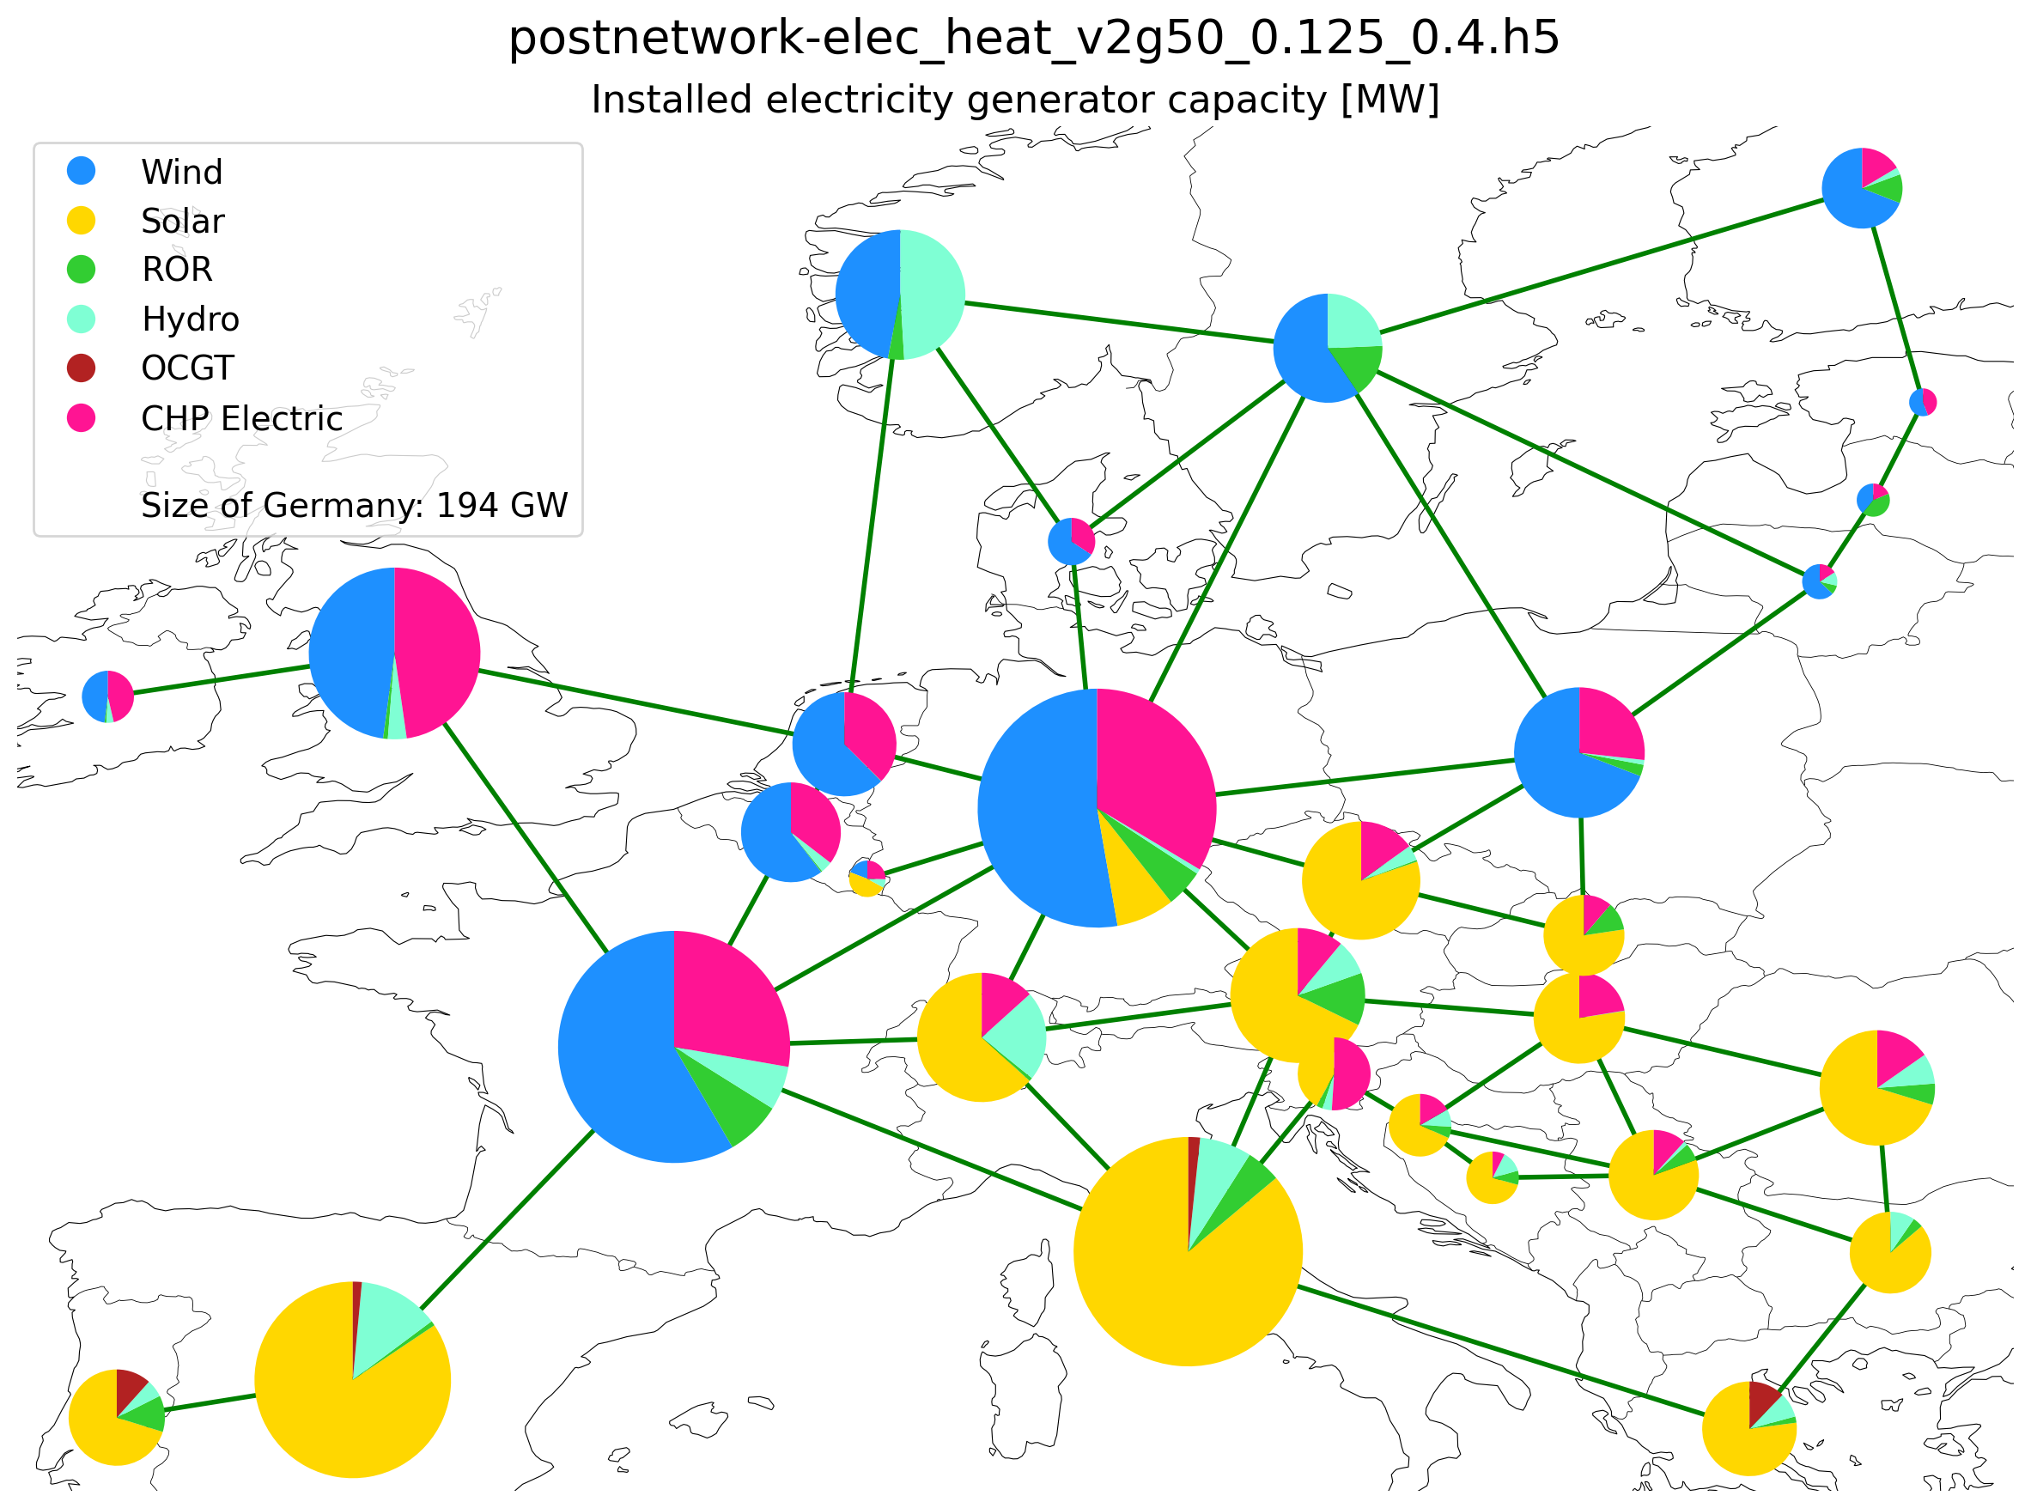
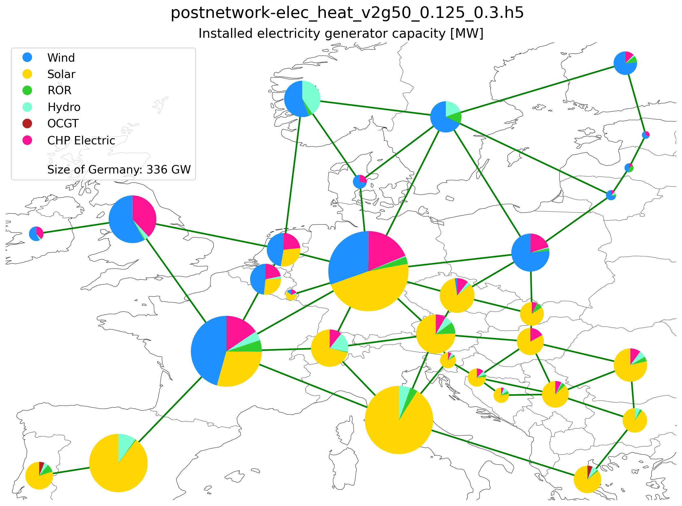
Installed capacity -
60% CO2 reduction
Installed capacity -
70% CO2 reduction

Slide 5
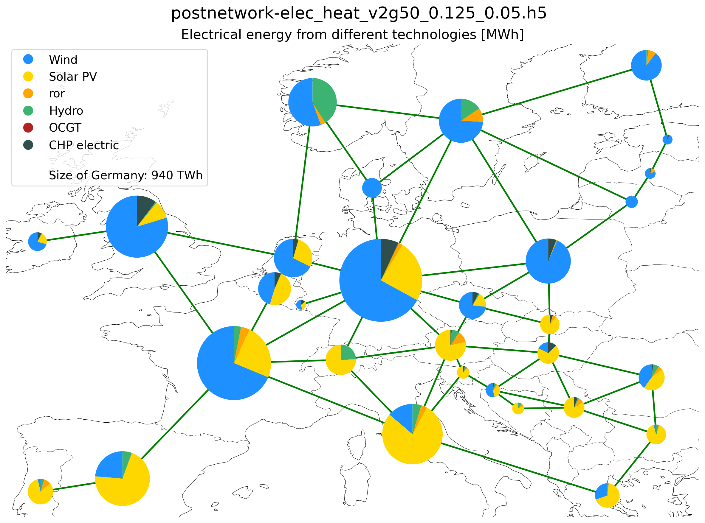
Electricity Supplied by Different Technologies (95% CO2 reduction)

Slide 6
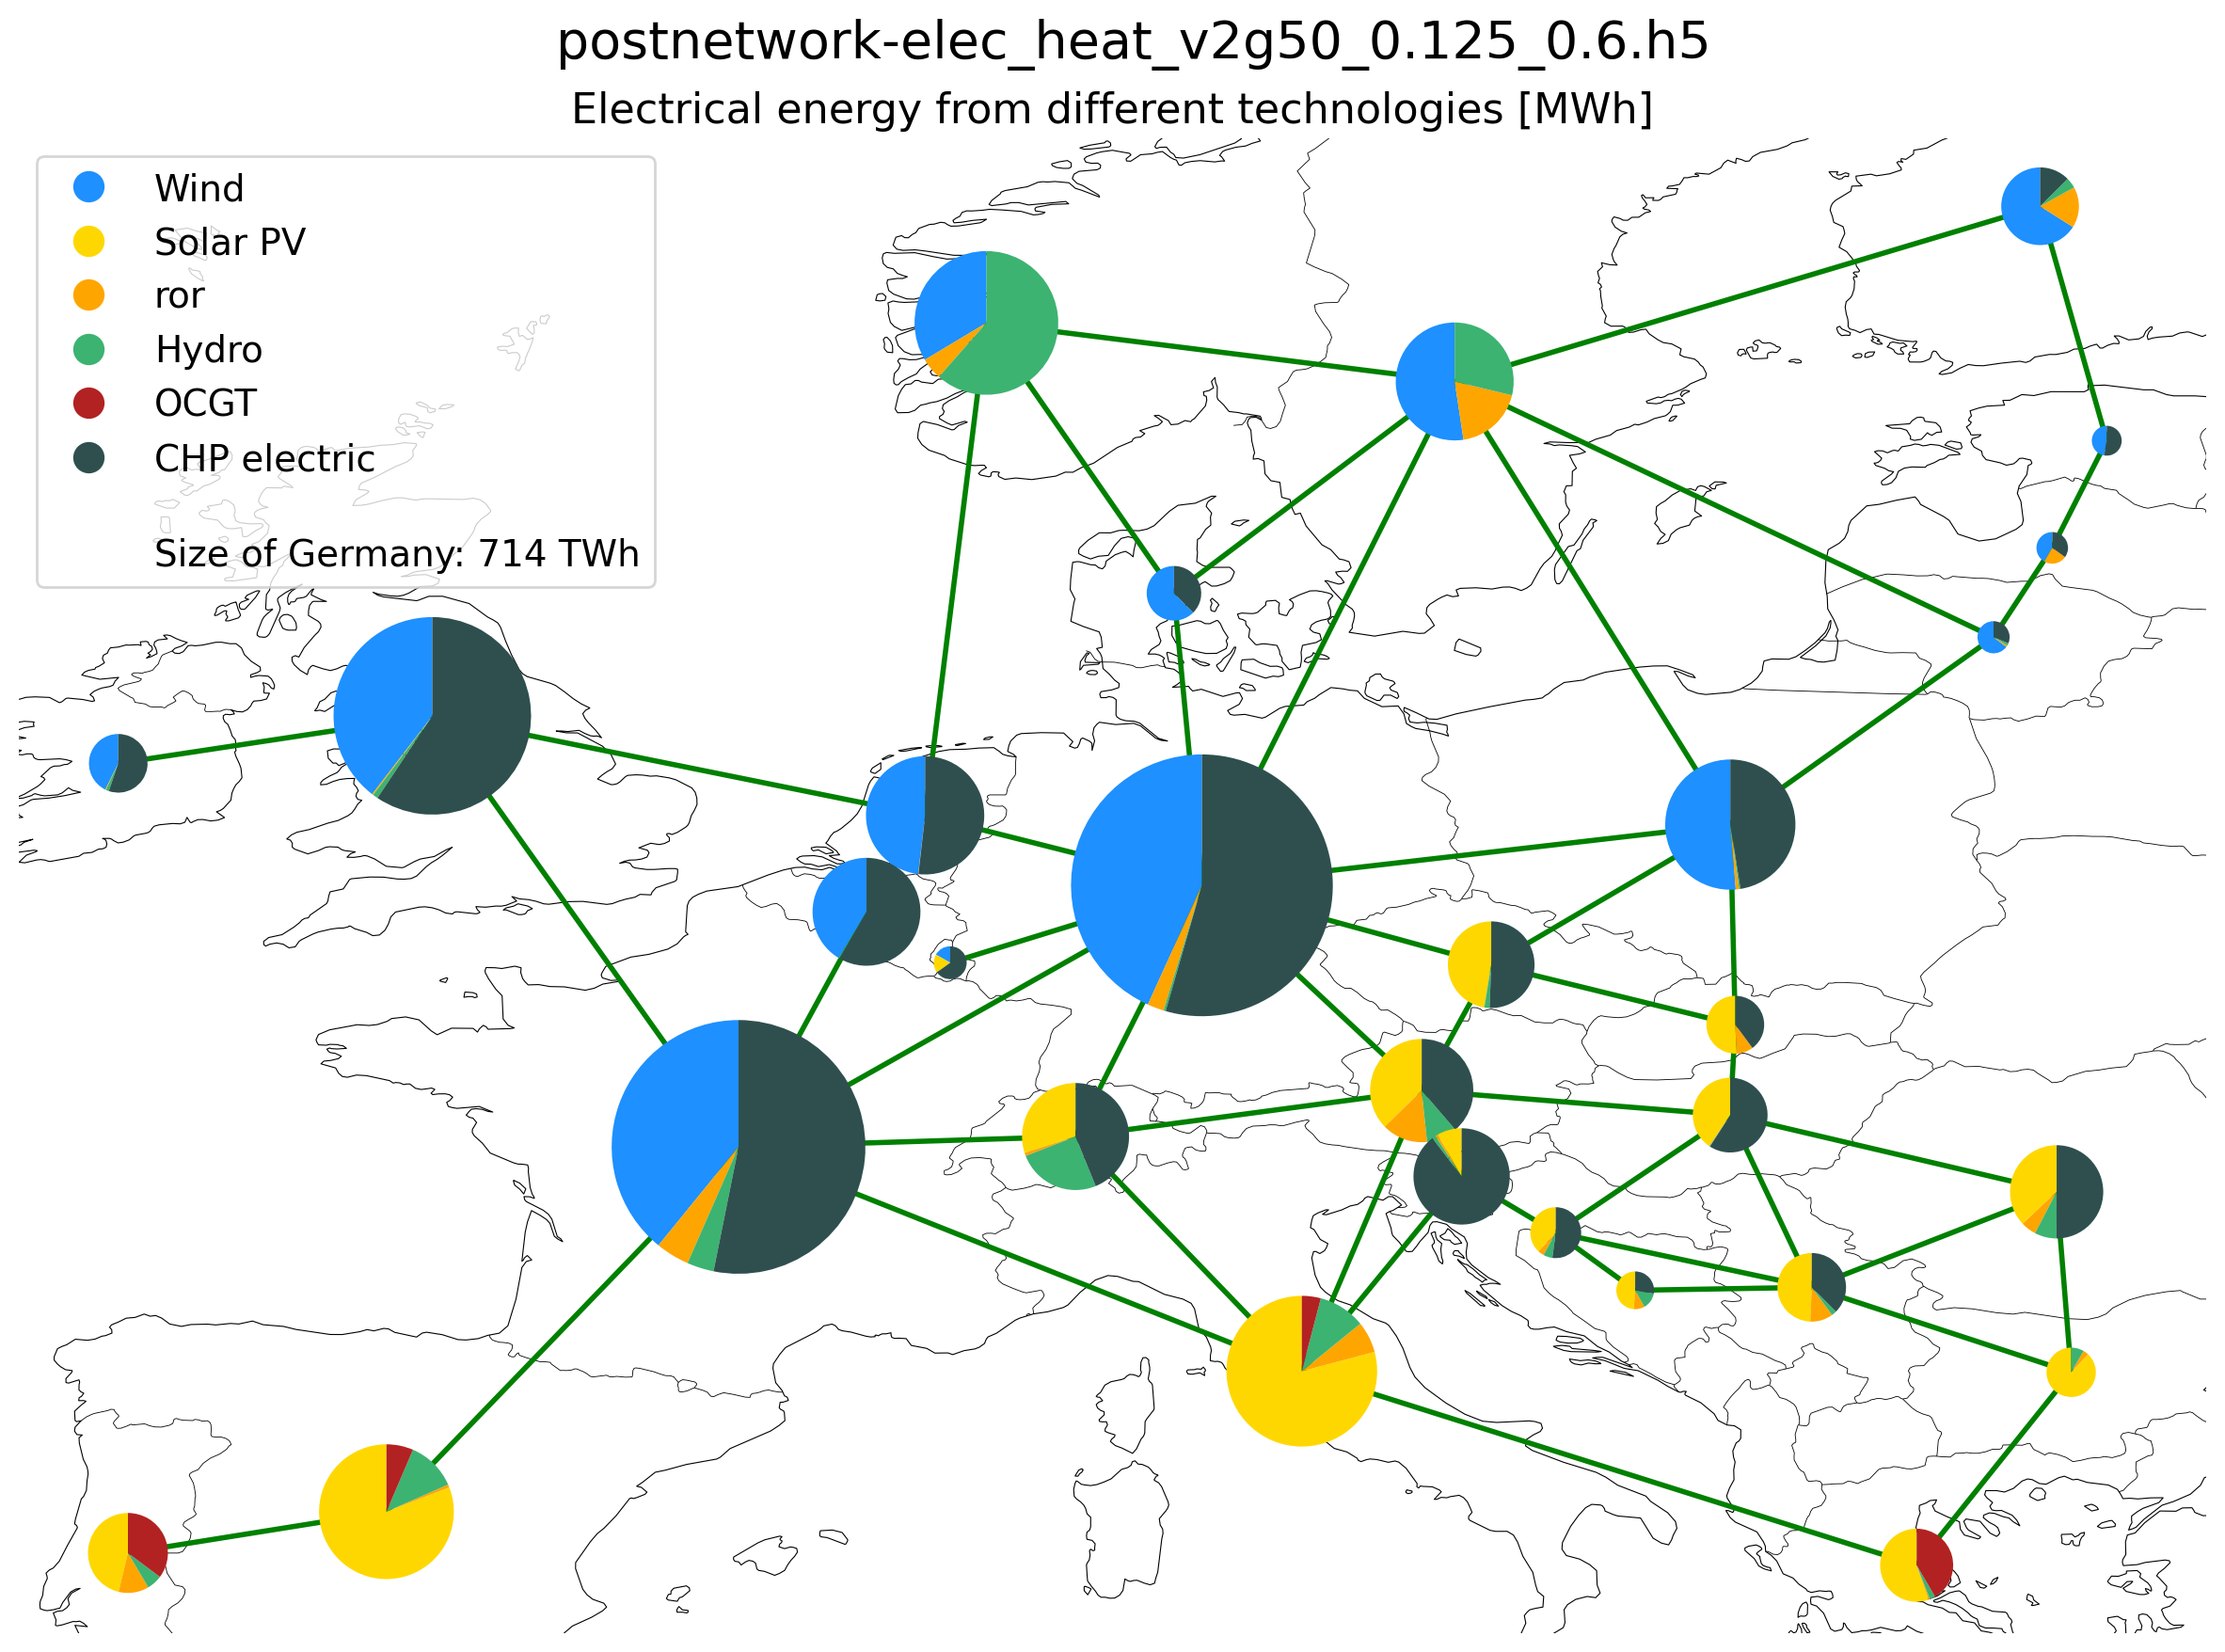

Electricity Supply -
40% CO2 reduction
Electricity Supply -
50% CO2 reduction

Slide 7

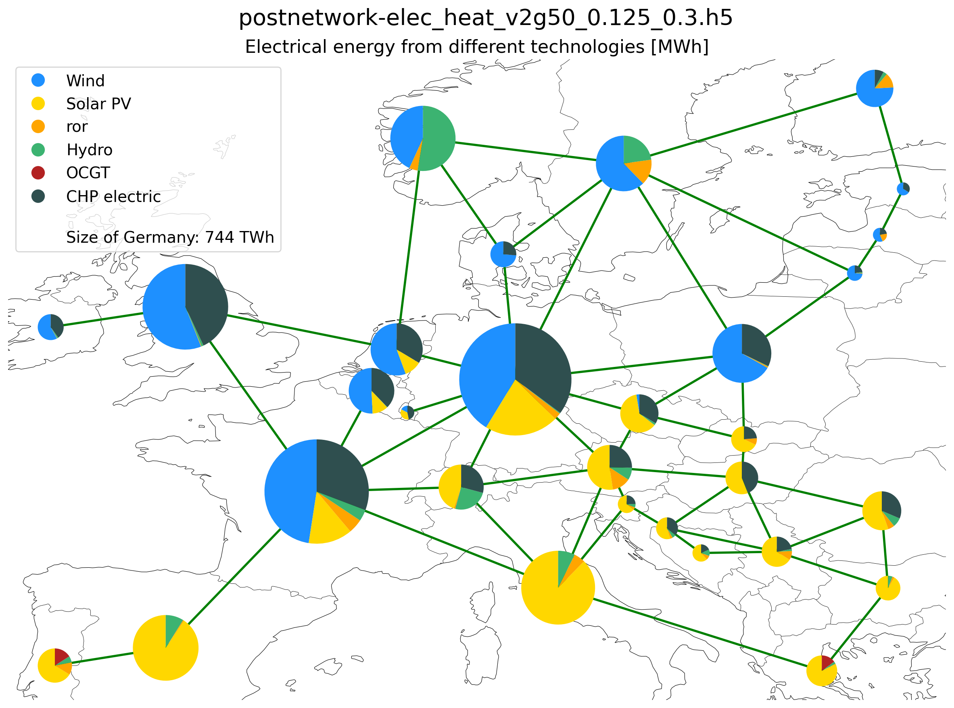
Electricity Supply -
60% CO2 reduction
Electricity Supply -
70% CO2 reduction

Slide 8
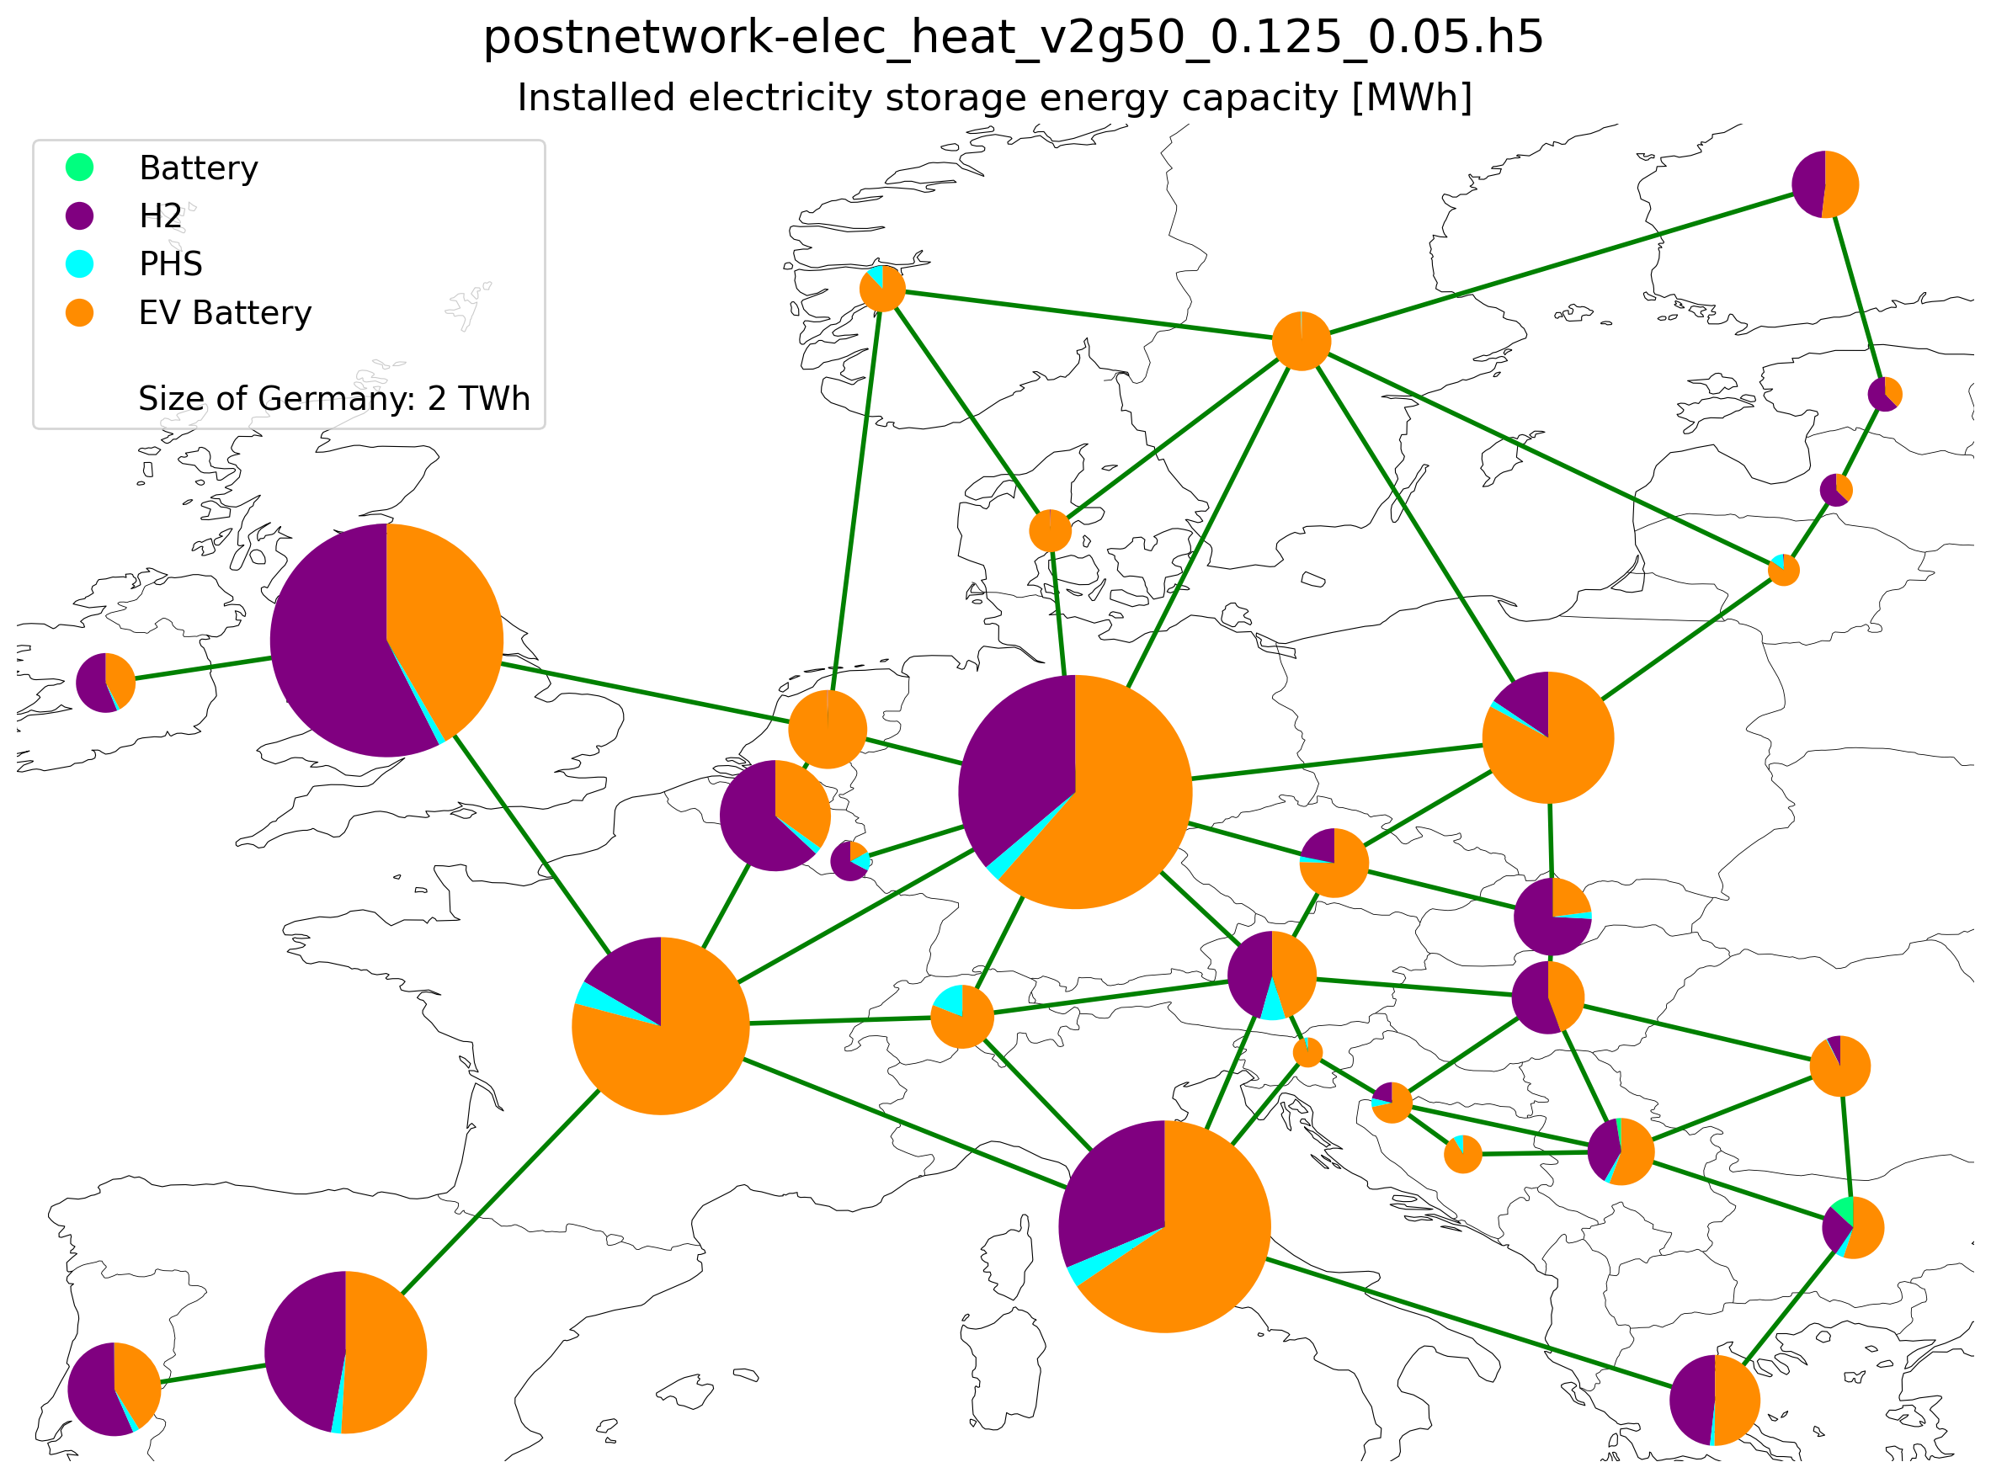
Installed storage (energy capacity) (95% CO2 reduction)

Slide 9
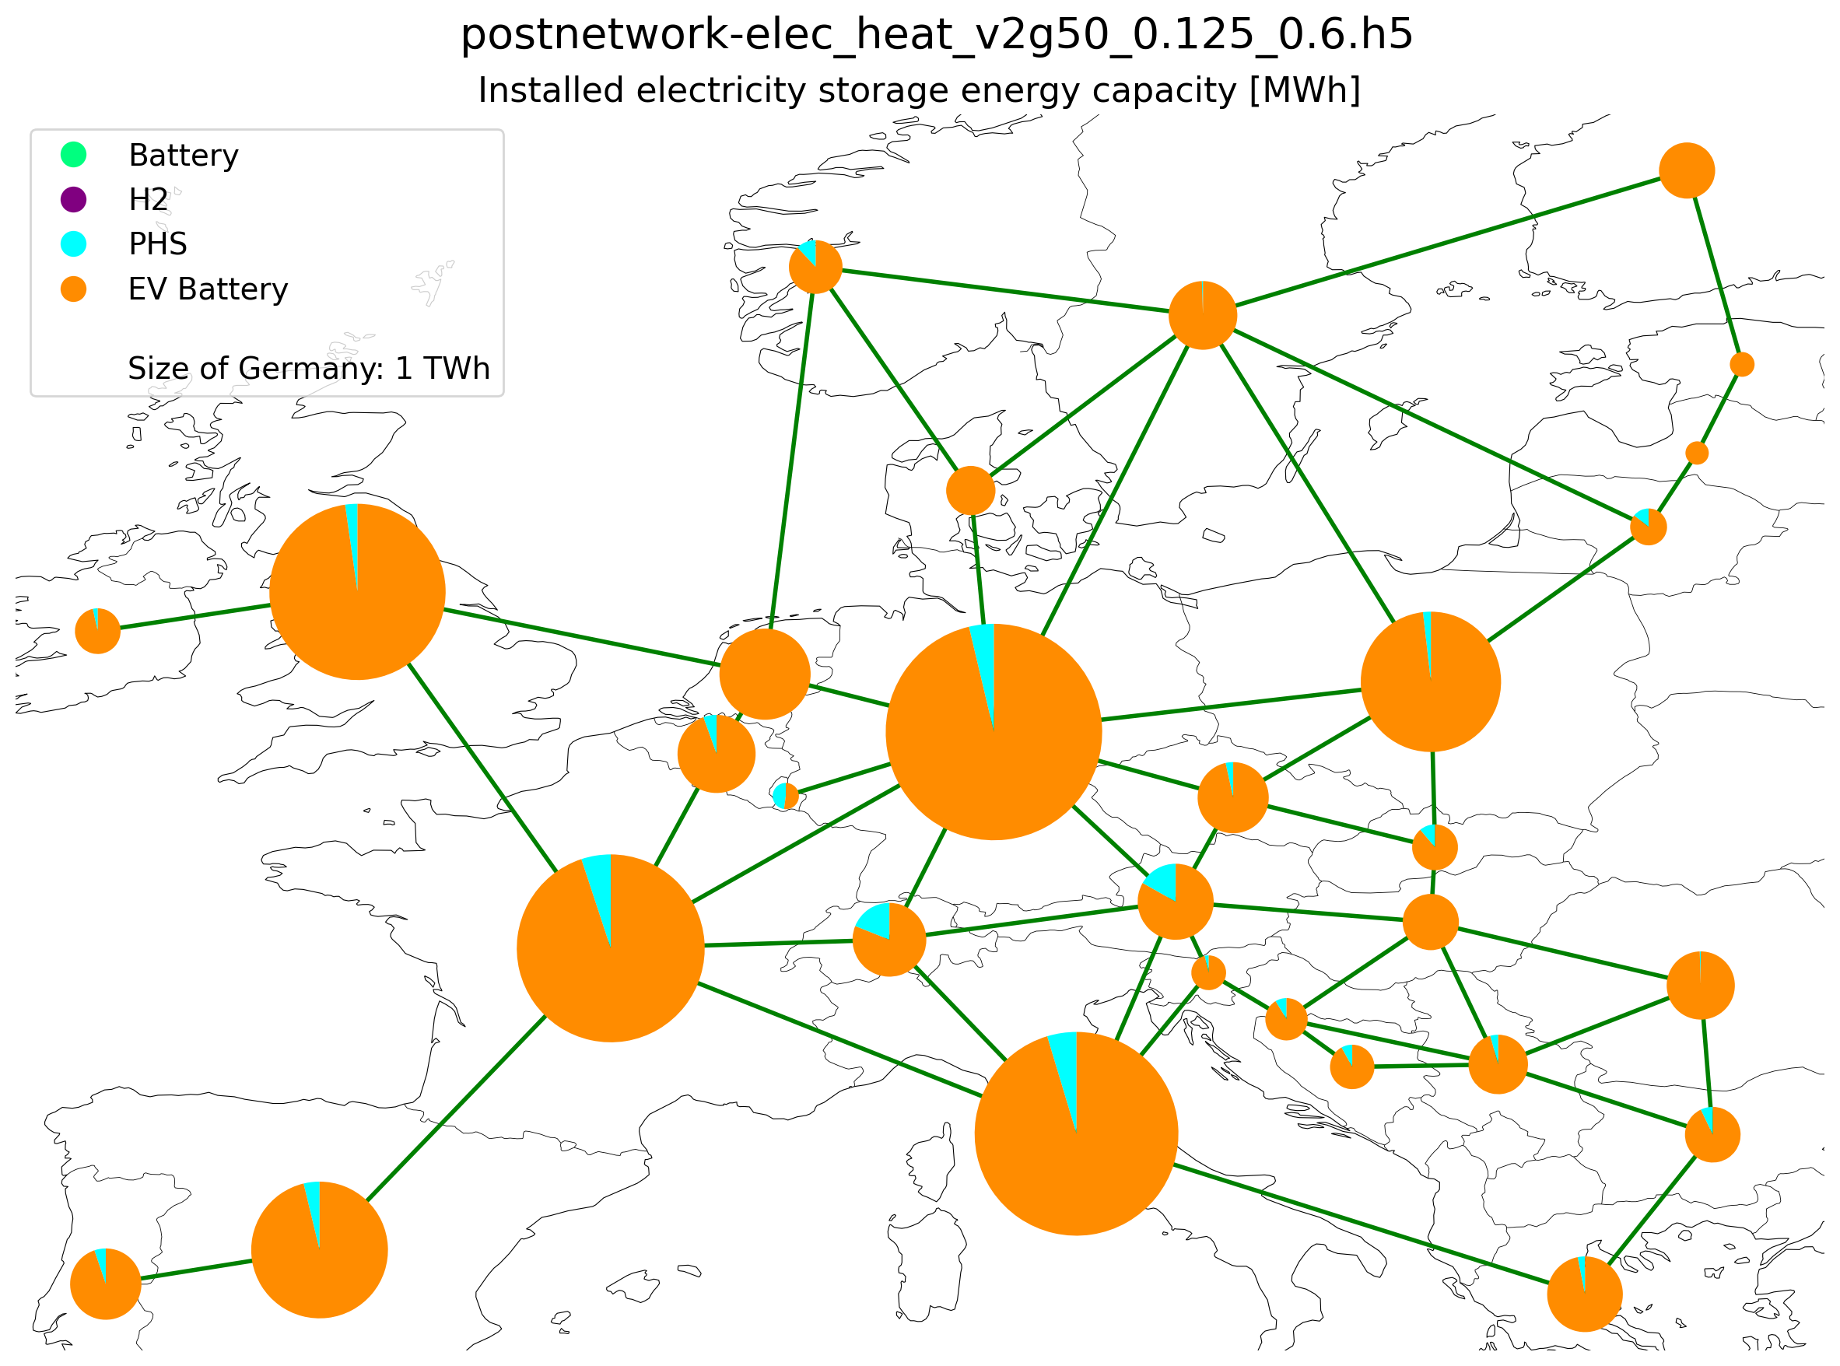

Electricity Storage Capacity -
40% CO2 reduction
Electricity Storage Capacity -
50% CO2 reduction

Slide 10


Electricity Storage Capacity -
60% CO2 reduction
Electricity Storage Capacity -
70% CO2 reduction

Slide 11
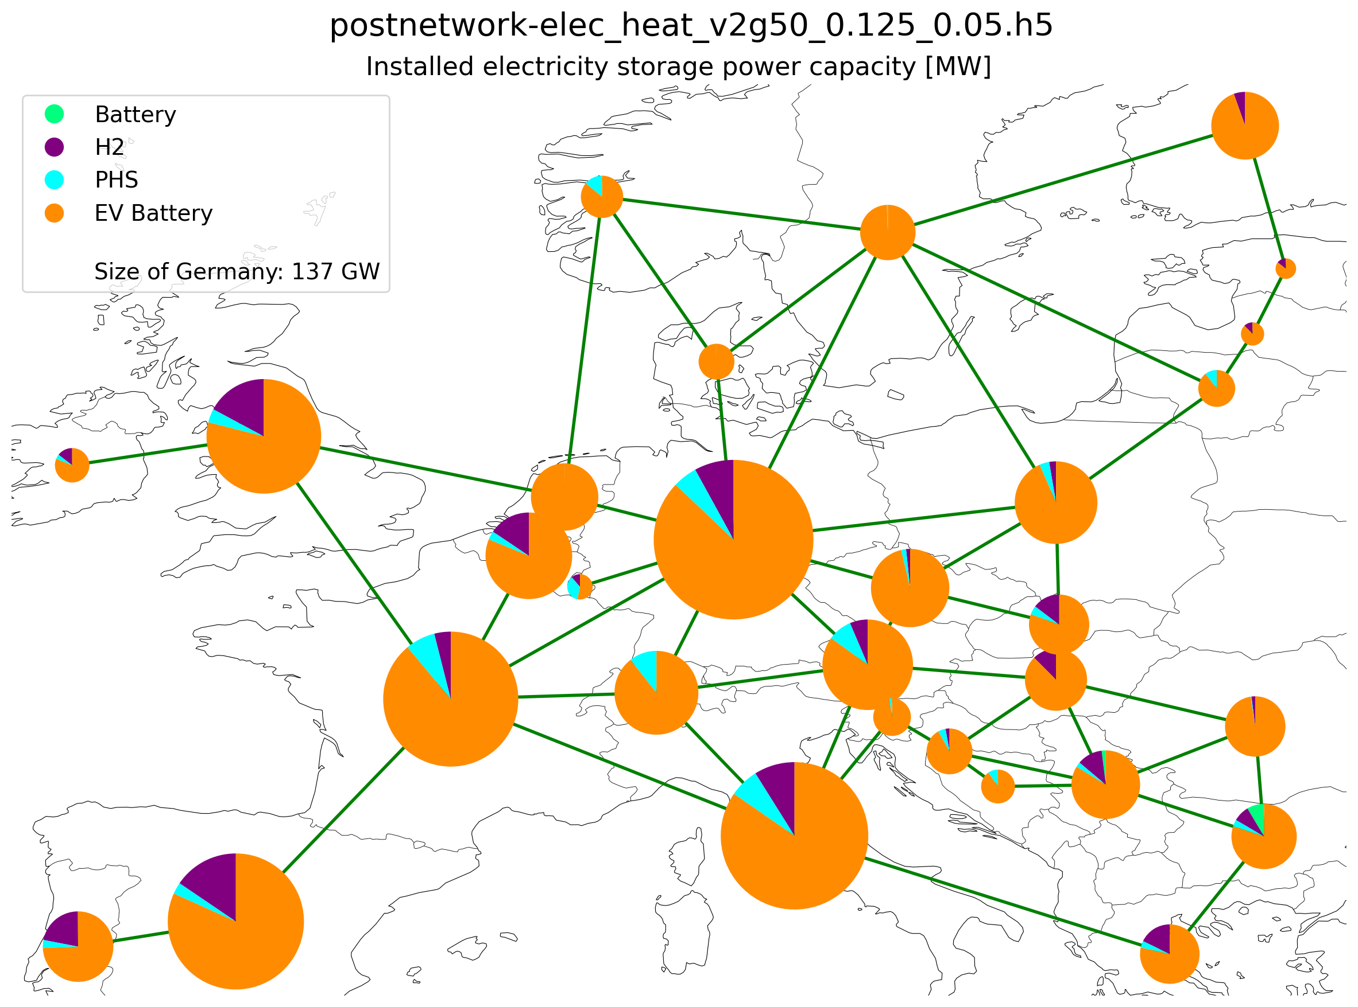
Installed storage (power capacity) (95% CO2 reduction)

Slide 12
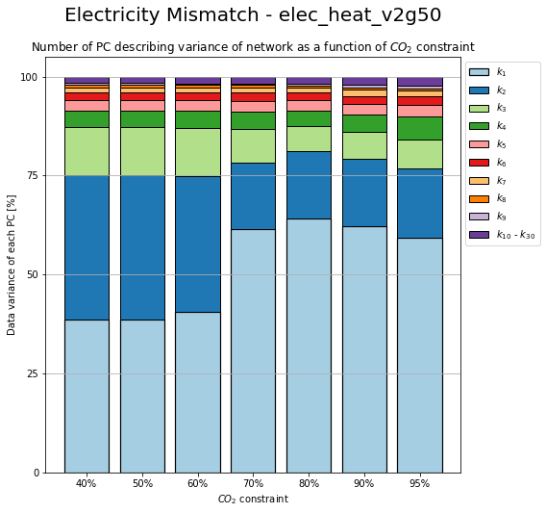
Change in PC due to CO2 Constrain

Slide 13
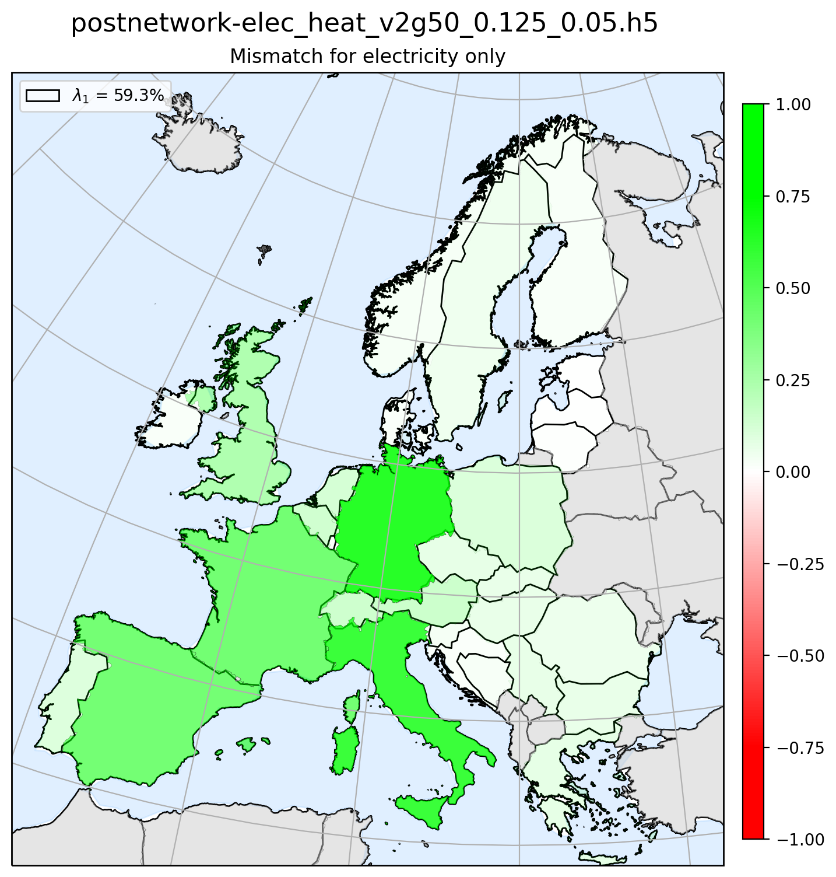
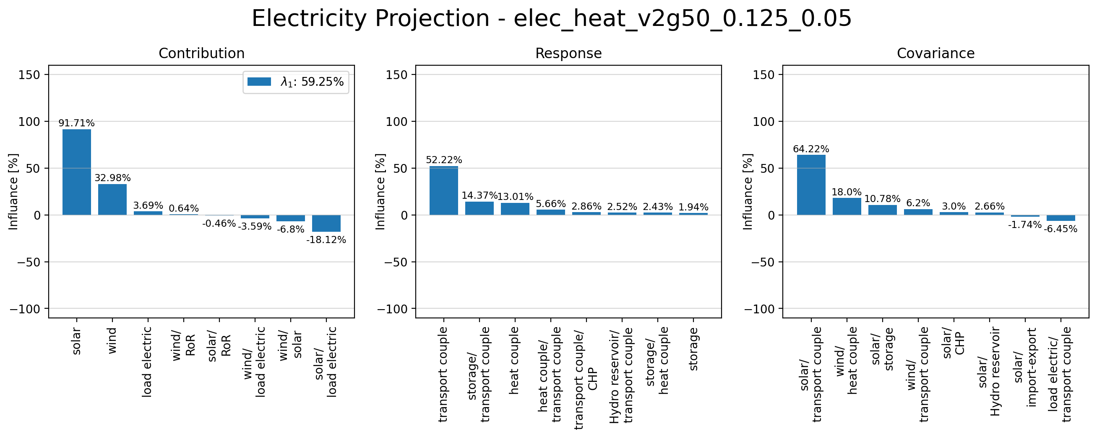
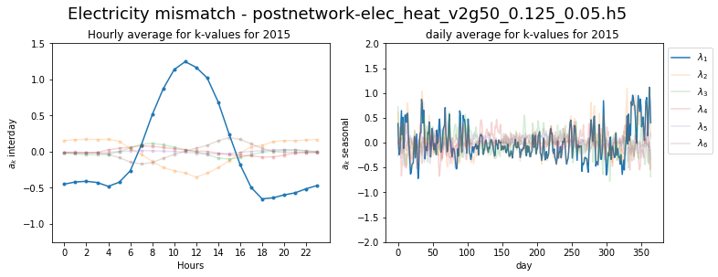
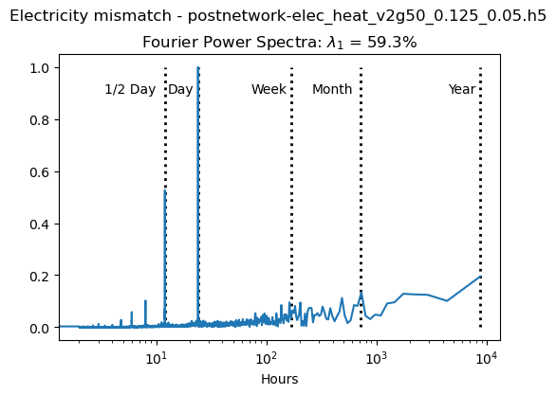
Principle Component 1

Slide 14
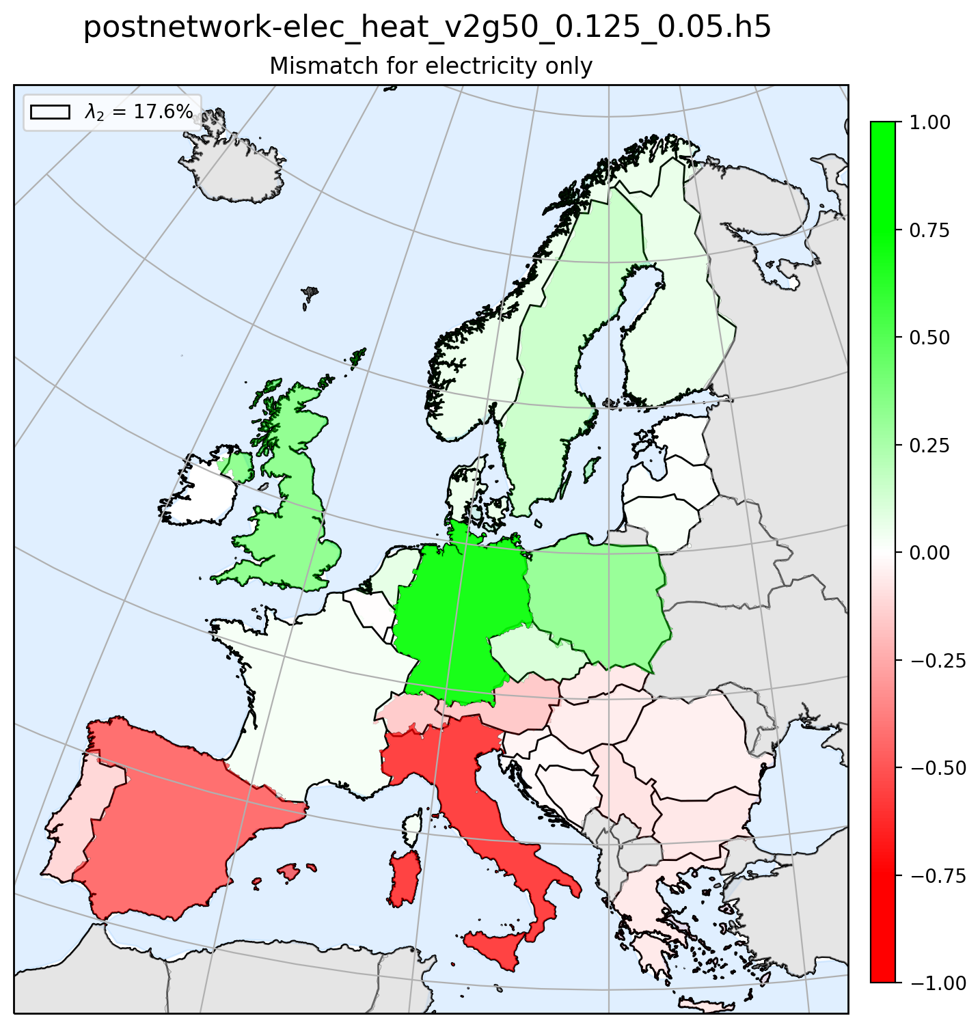
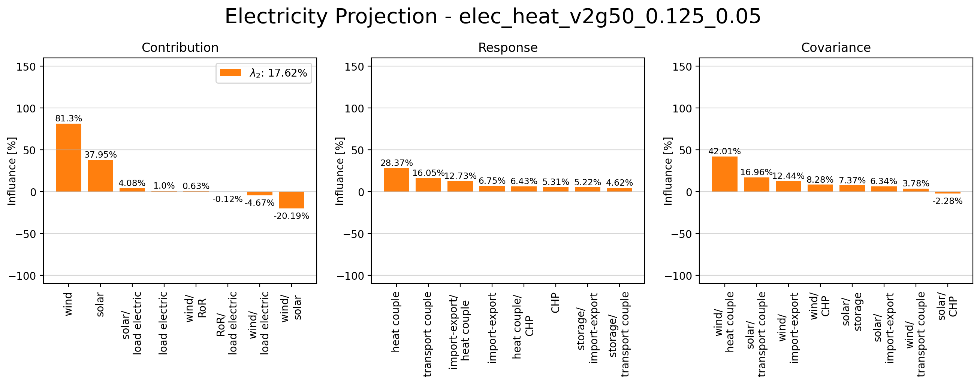
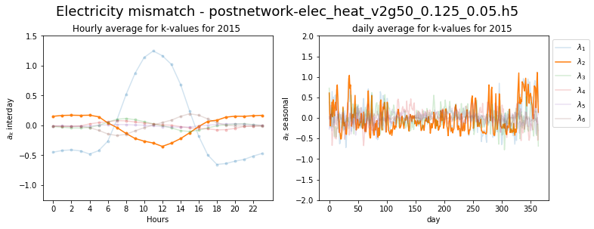
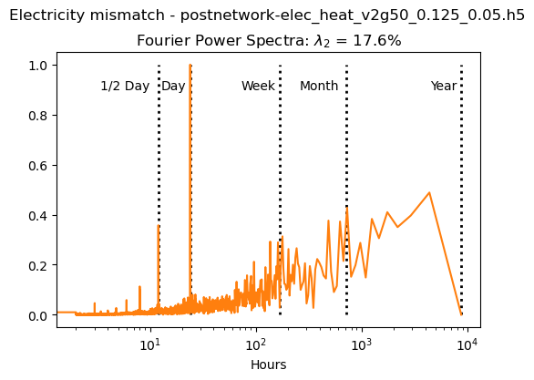
Principle Component 2

Slide 15
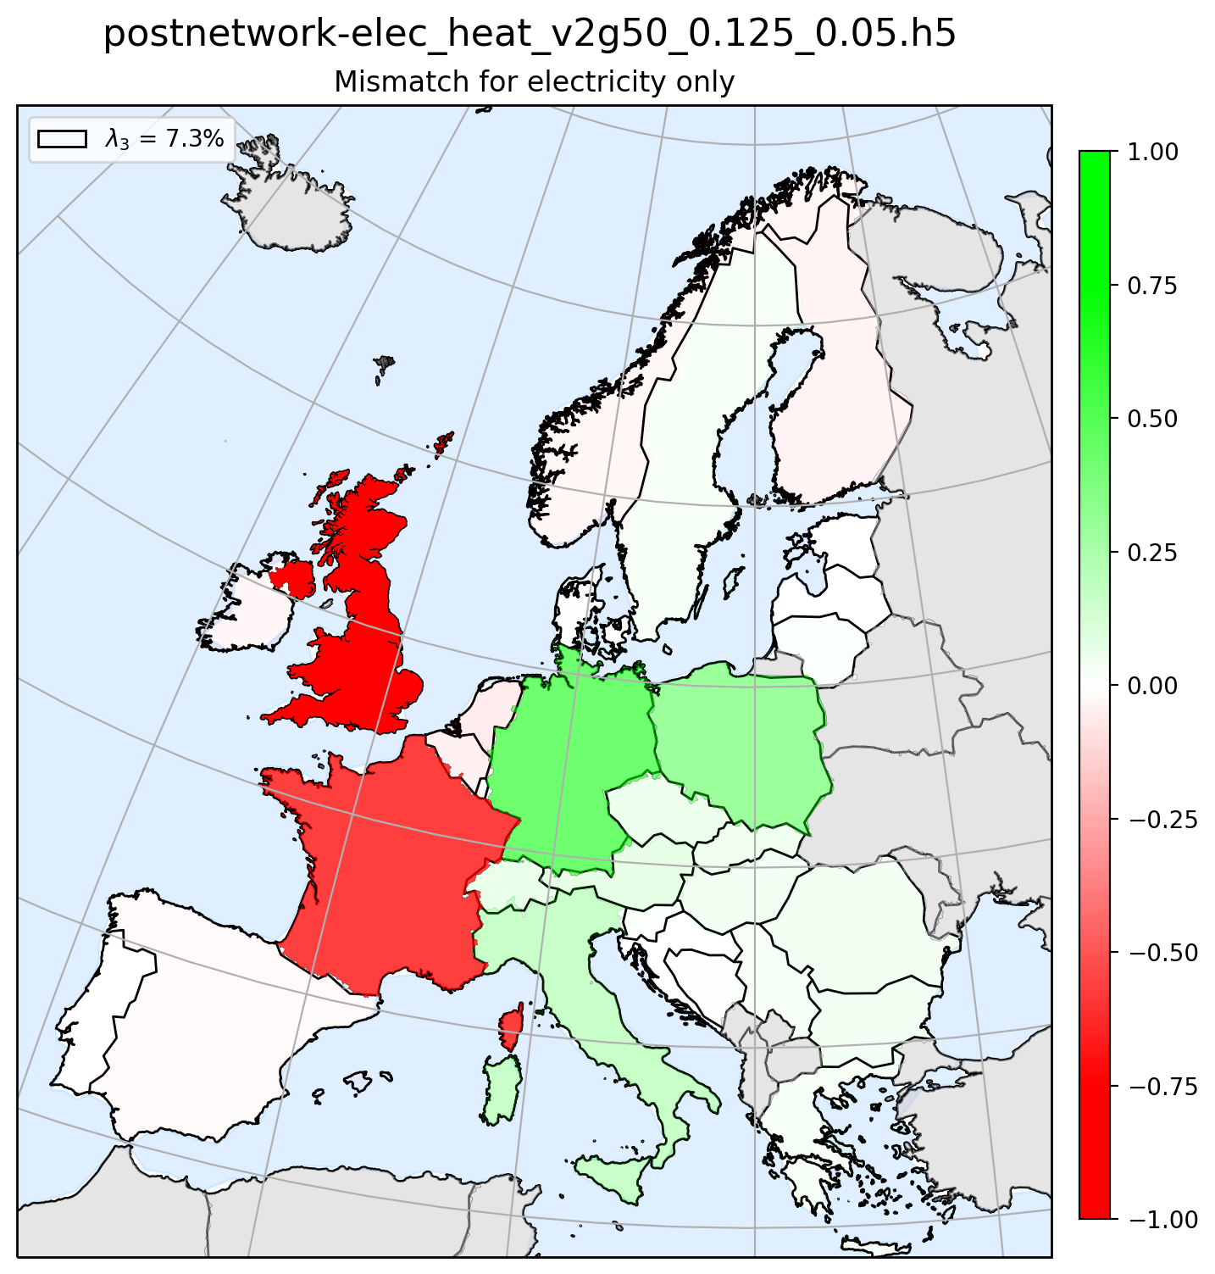
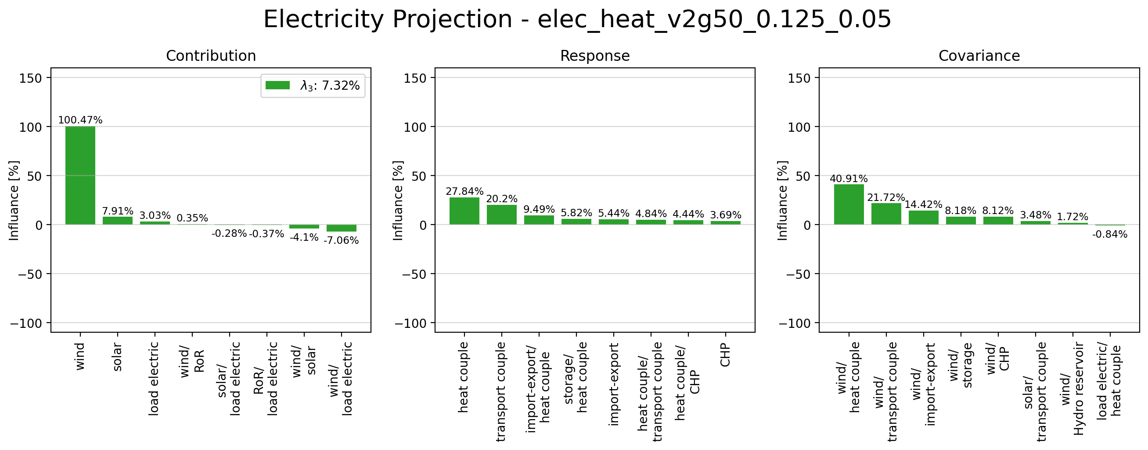
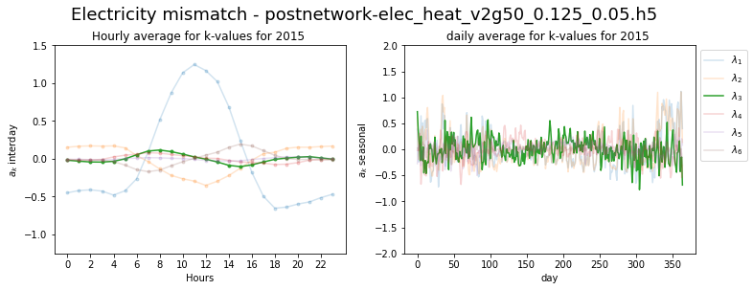
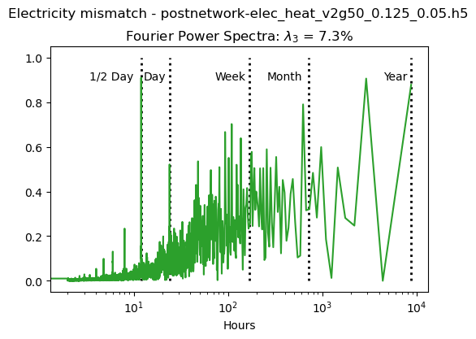
Principle Component 3

Slide 16
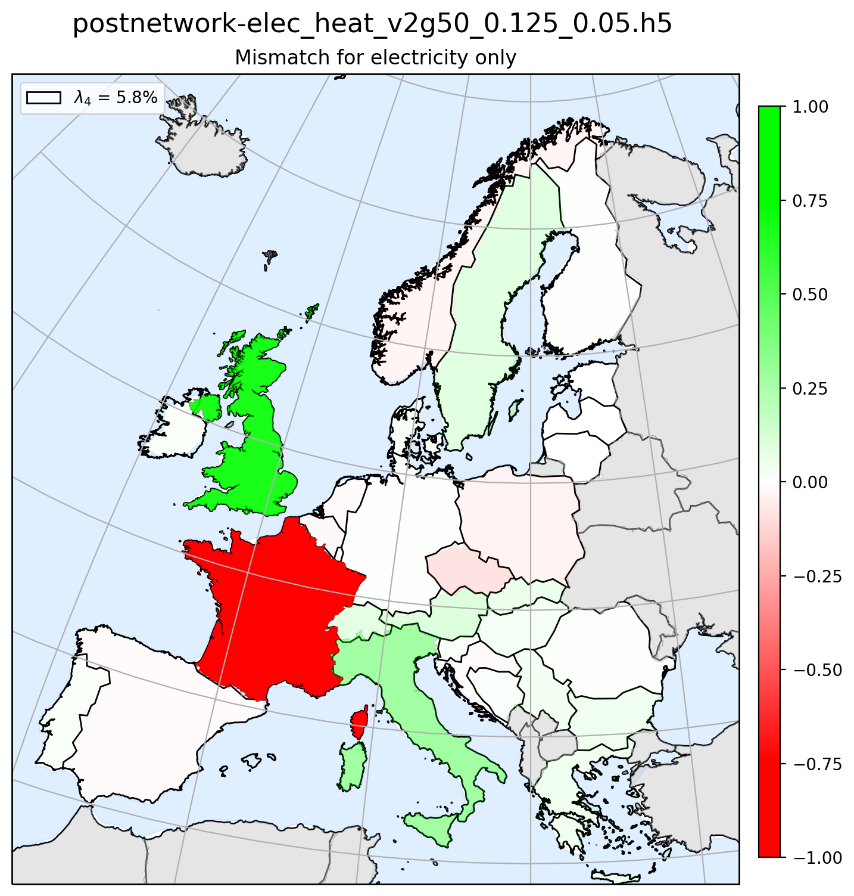
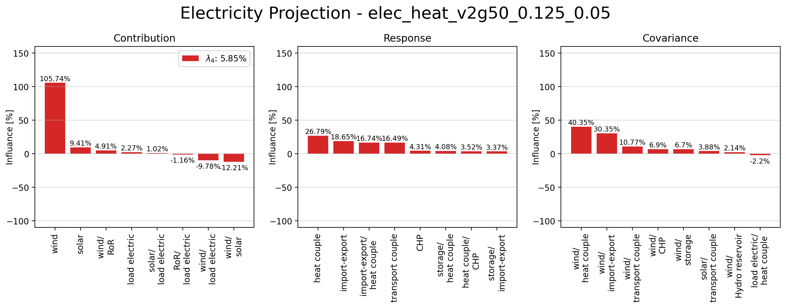
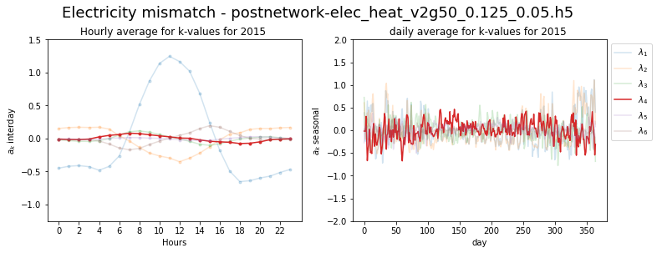
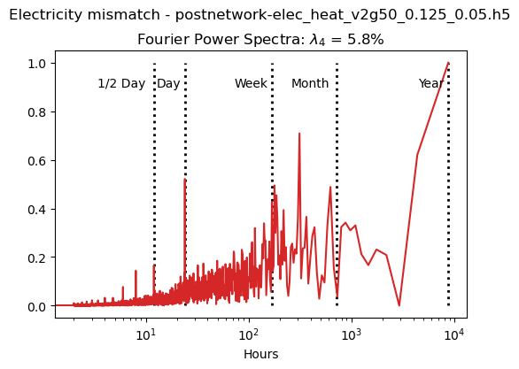
Principle Component 4

Slide 17
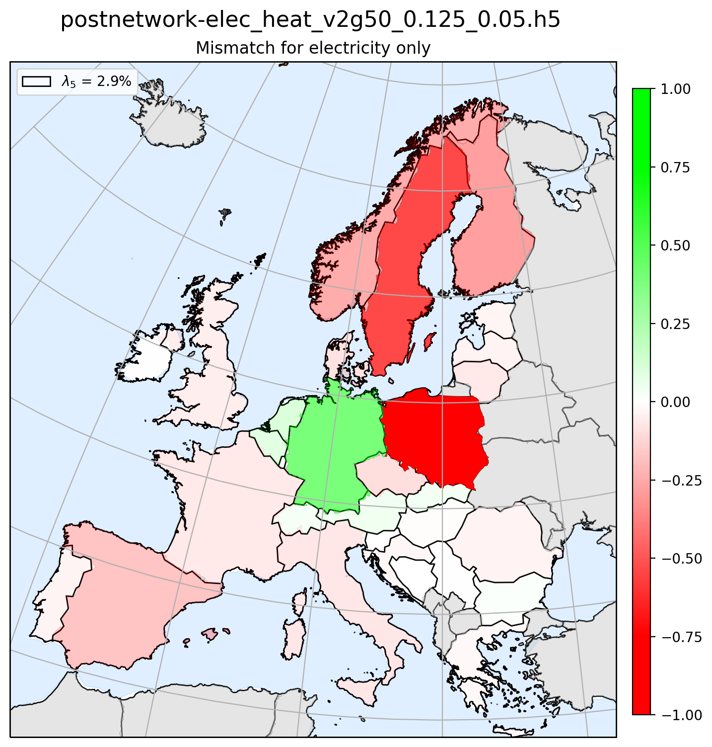
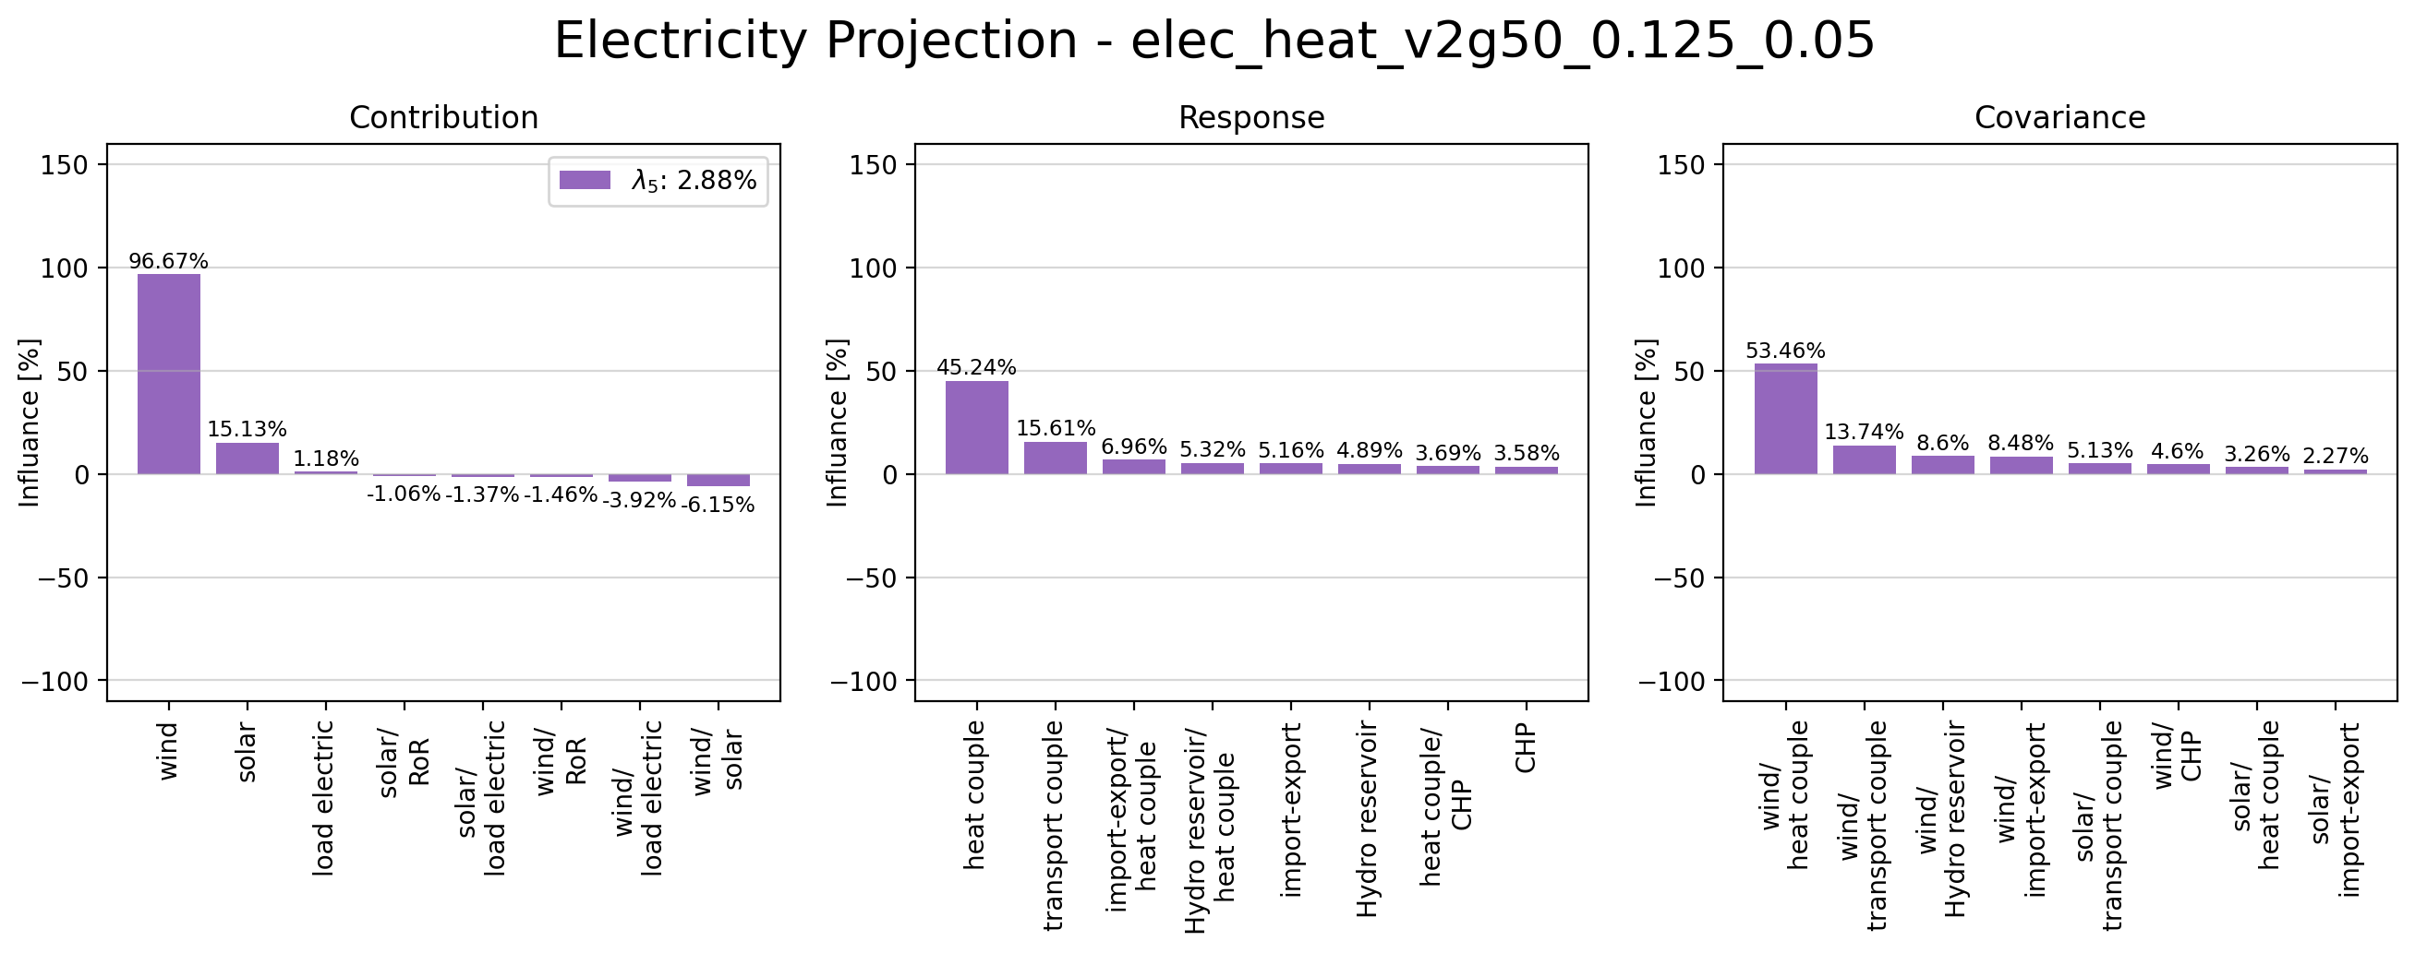
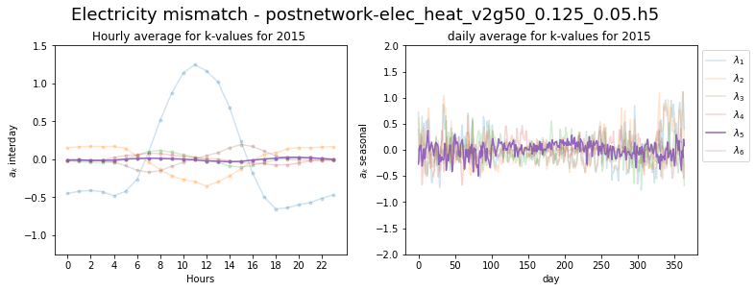
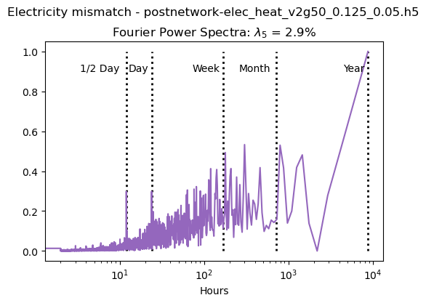
Principle Component 5

Slide 18
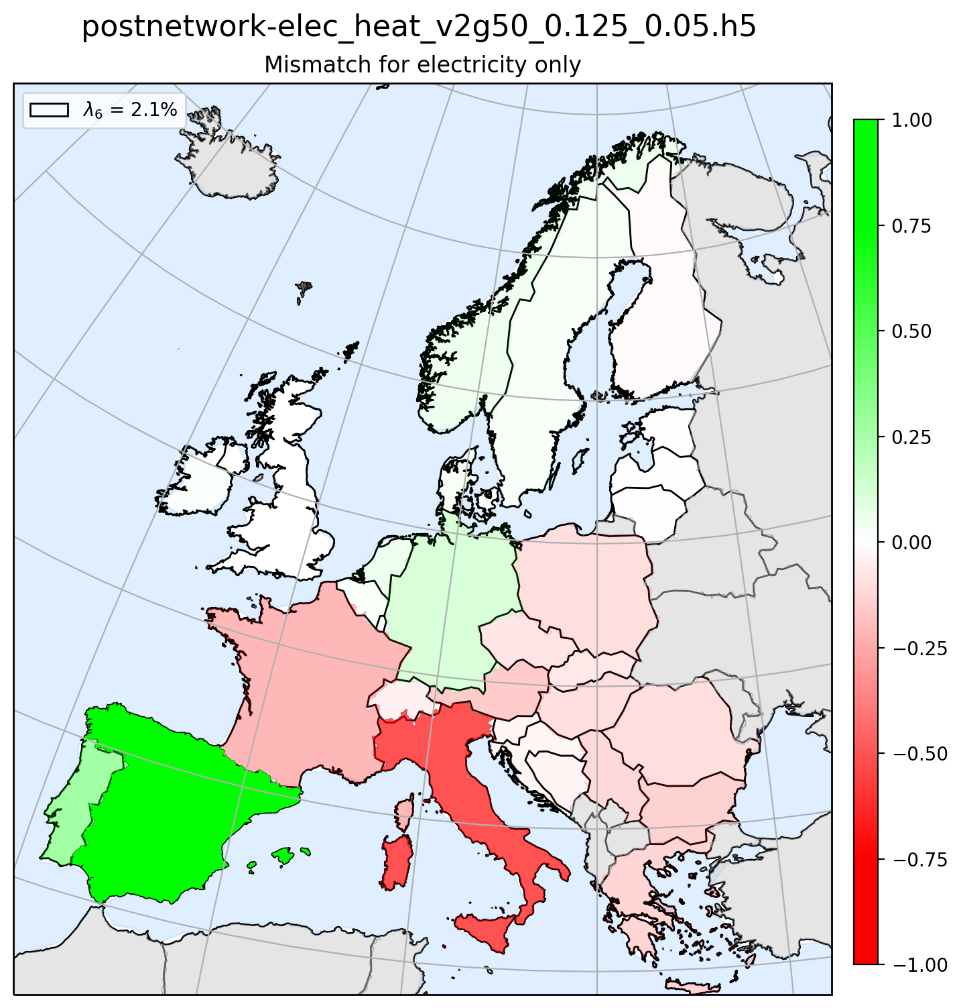
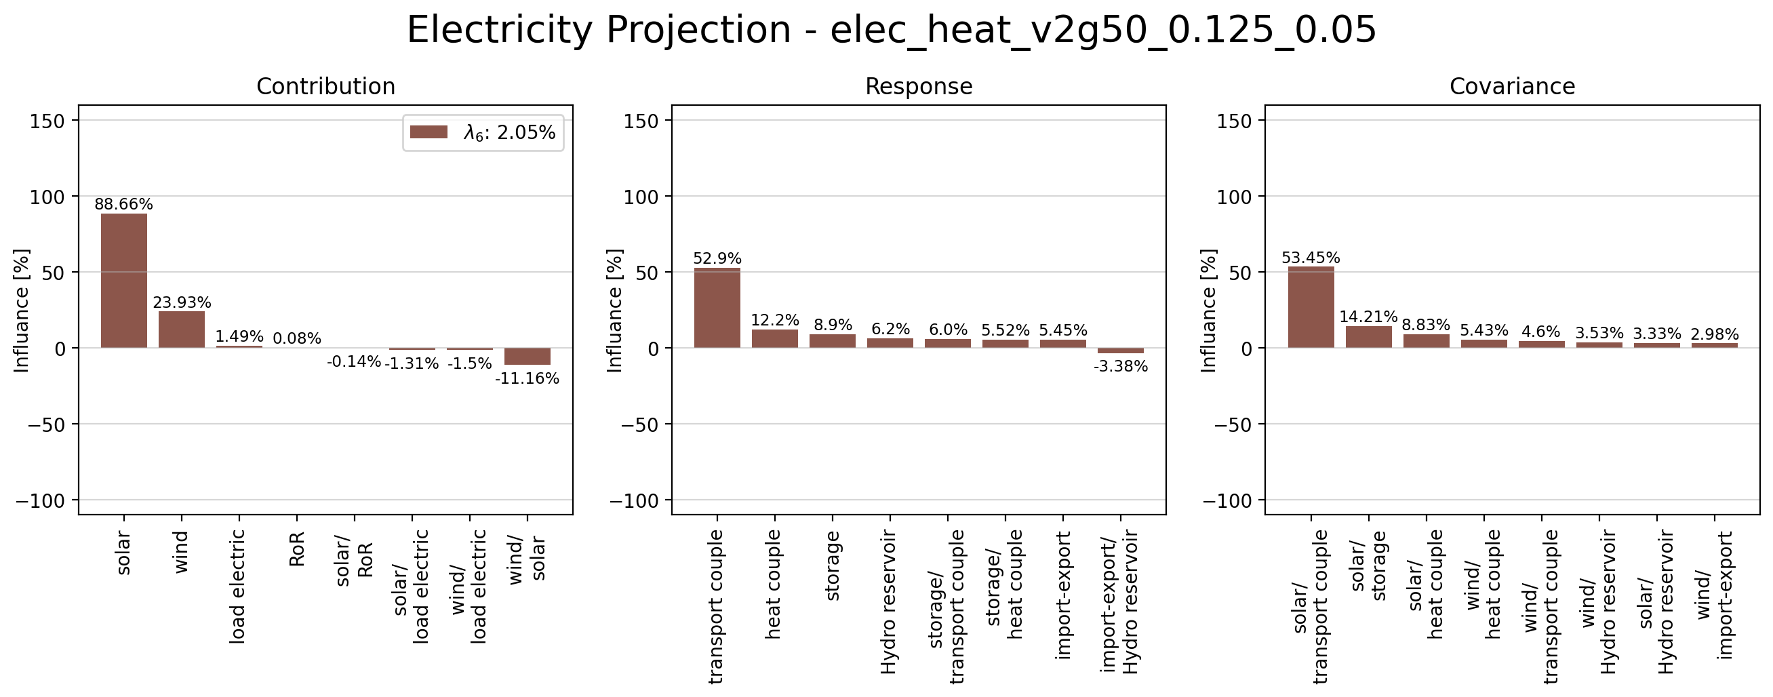
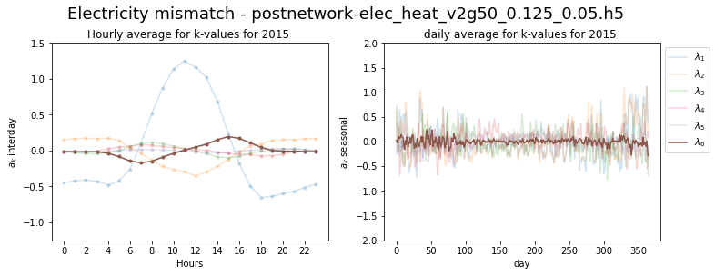
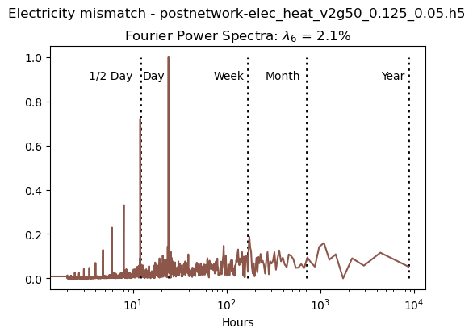
Principle Component 6

Slide 19
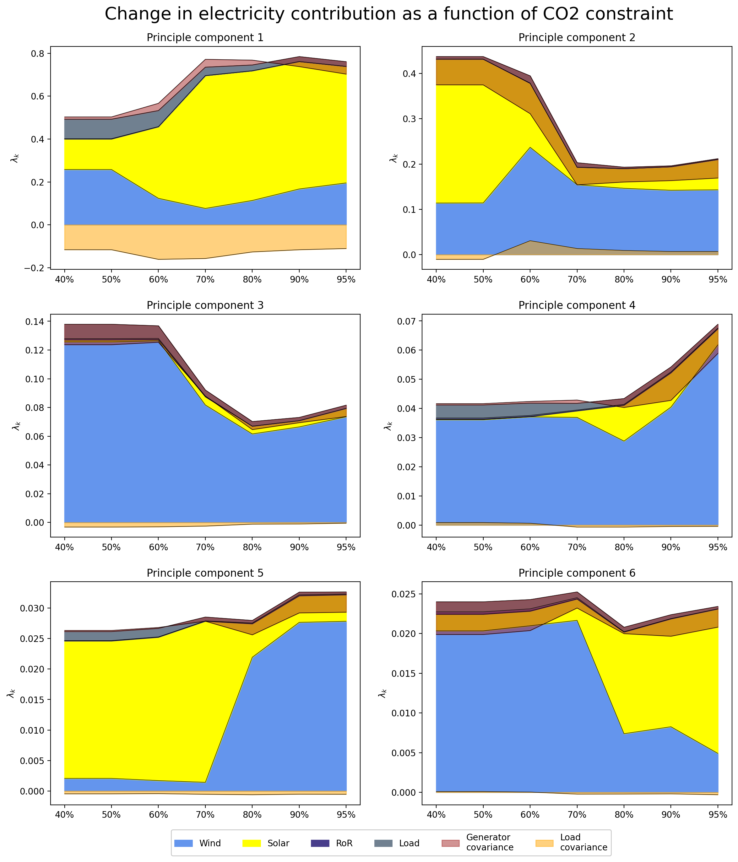
Change in Contribution due to CO2 Constrain

Slide 20
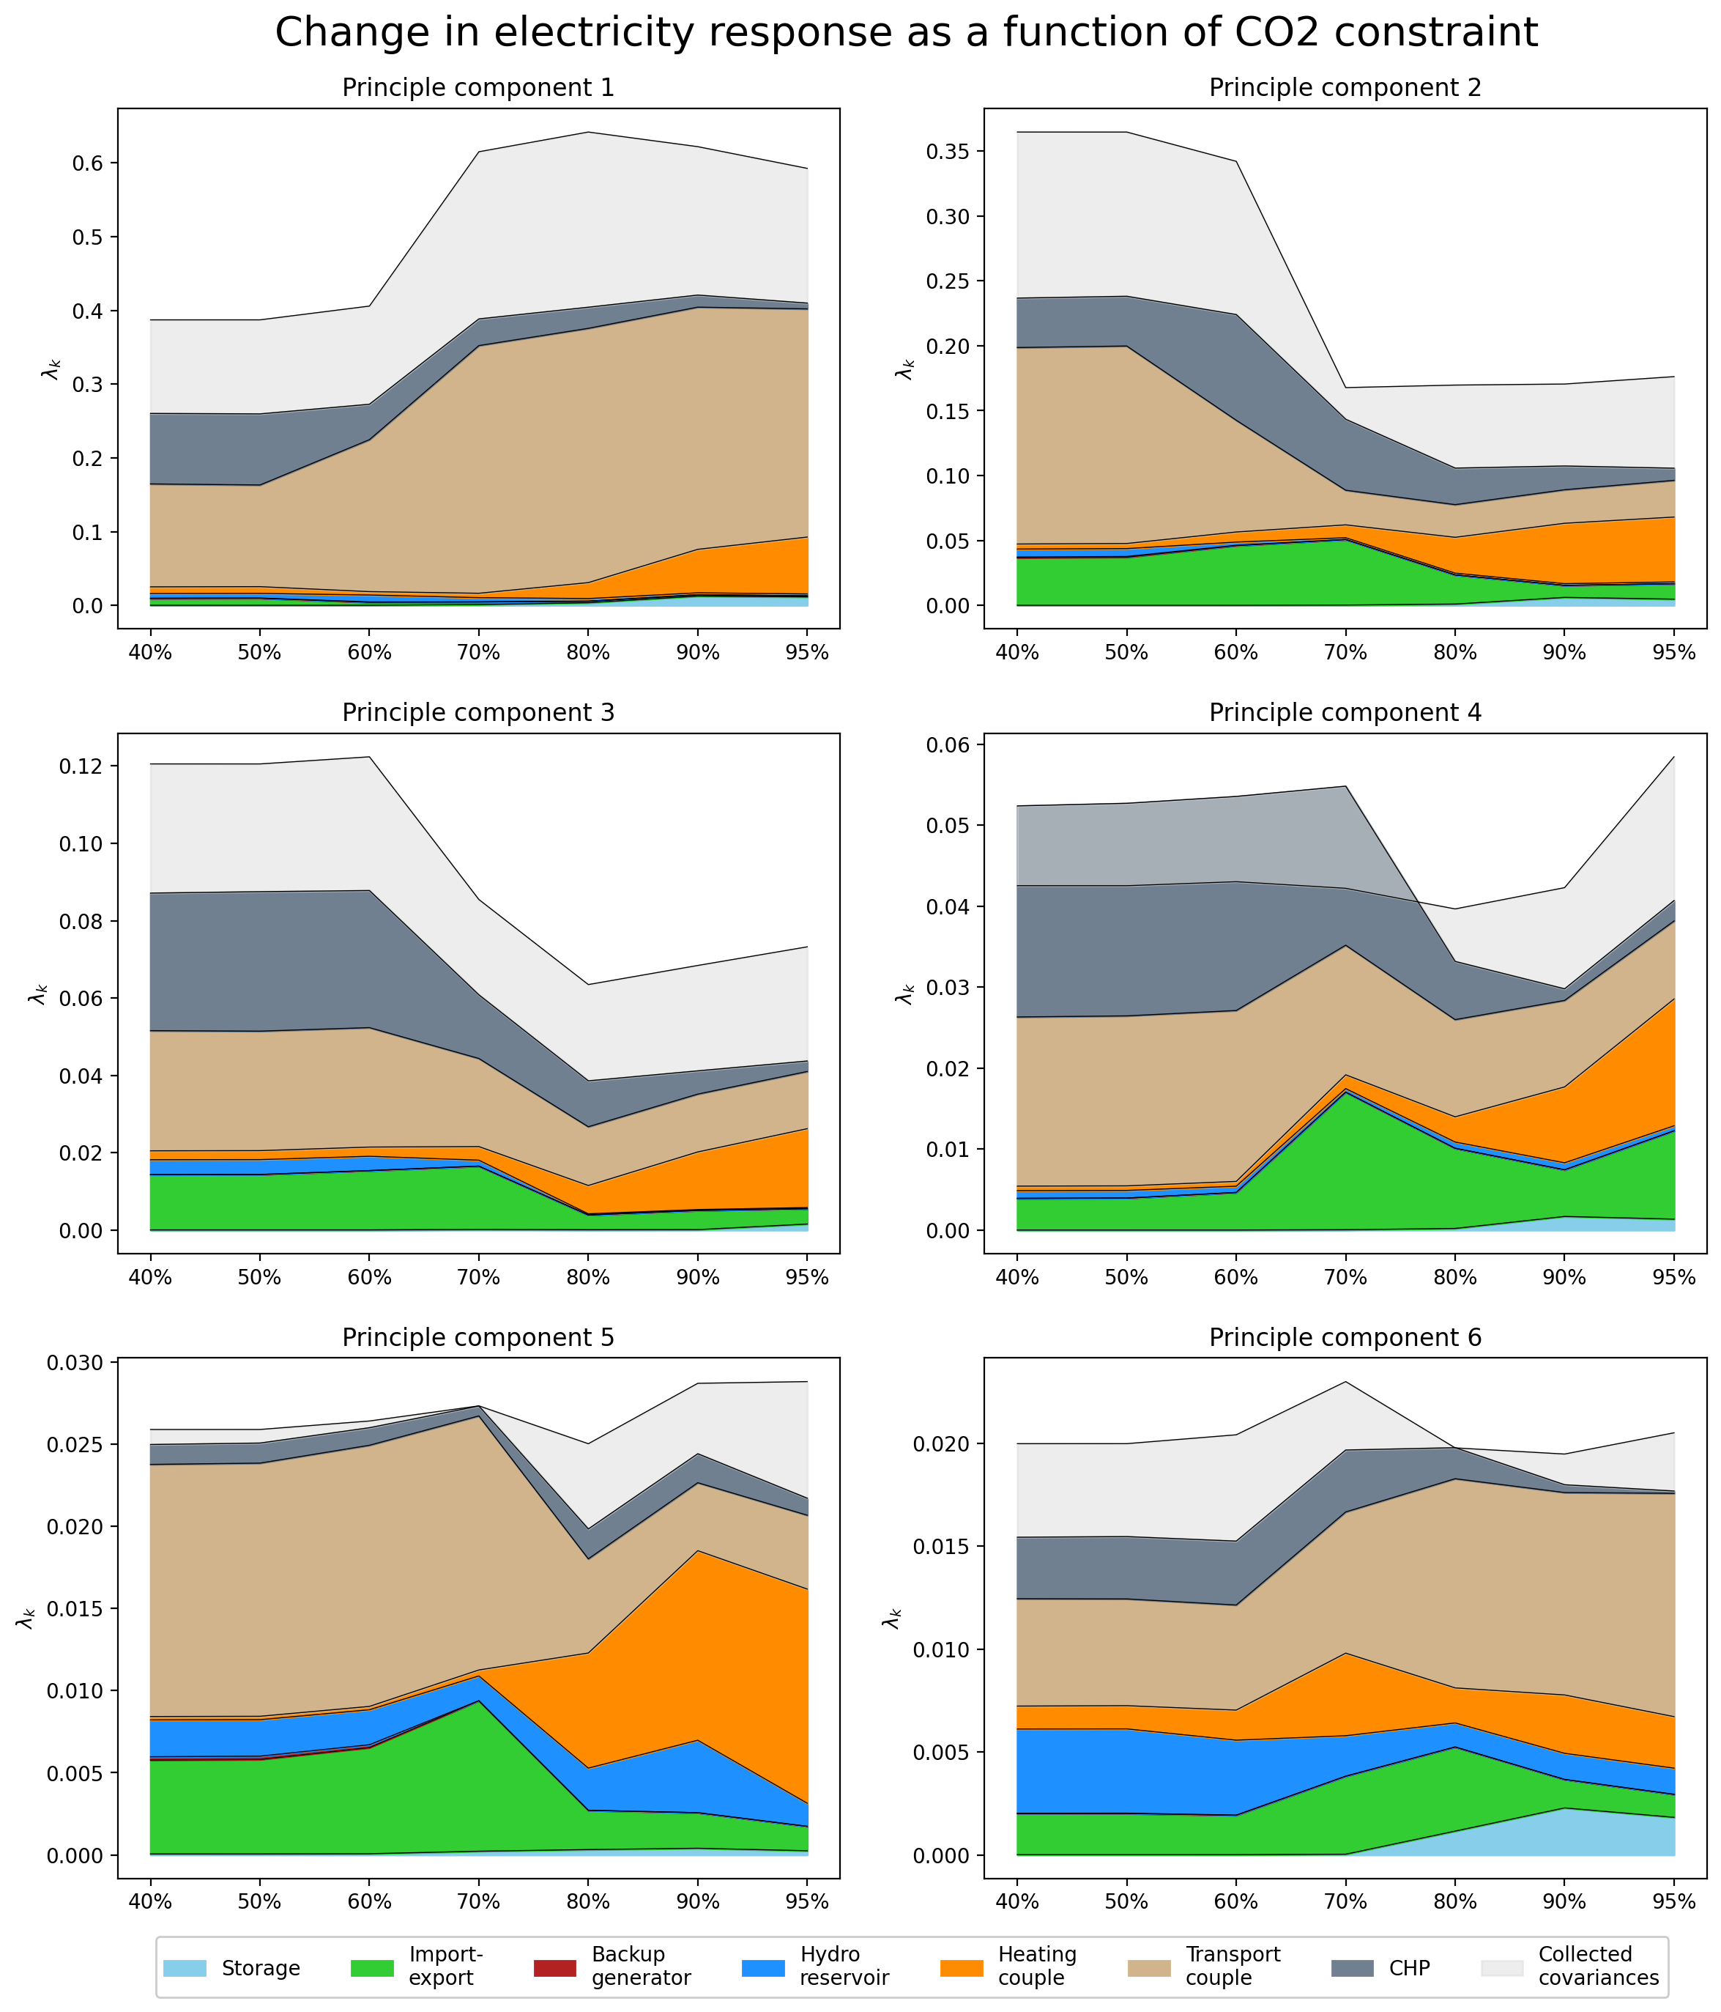
Change in Reponse due to CO2 Constrain

Slide 21
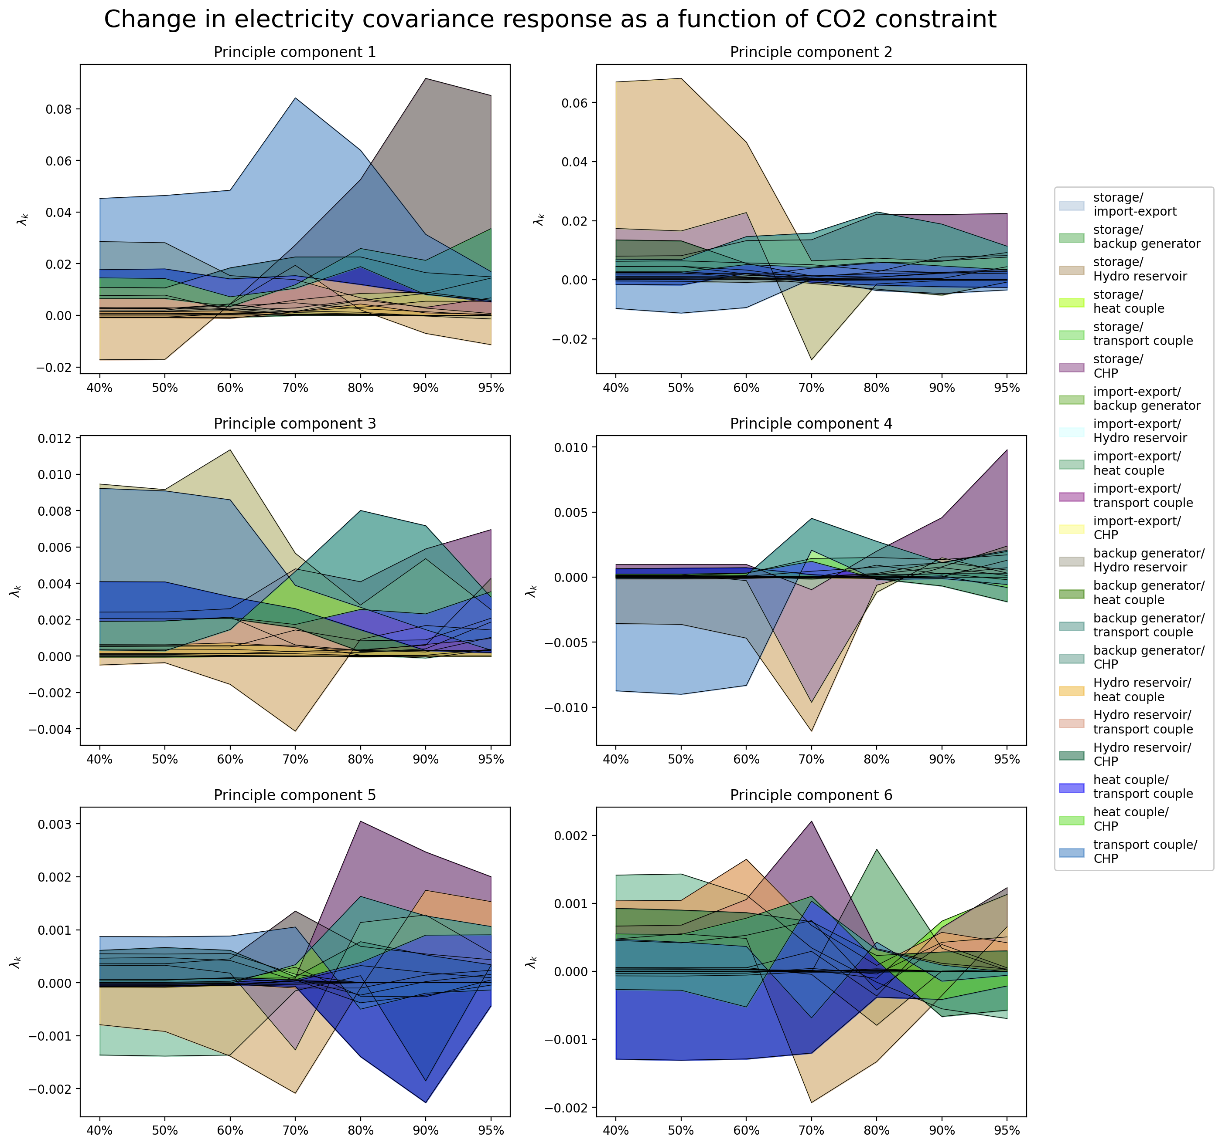
Change in Cov Reponse due to CO2 Constrain

Slide 22
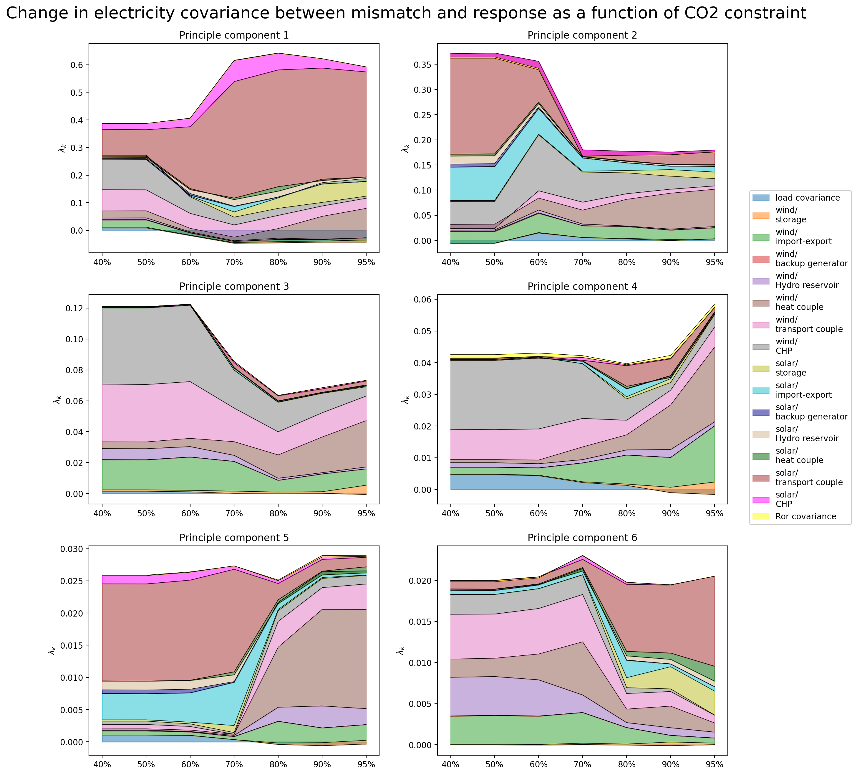
Change in Covariance due to CO2 Constrain

Slide 23
Electricity Coupled with the Heating and Transport Sector
Electricity NP Analysis

Slide 24
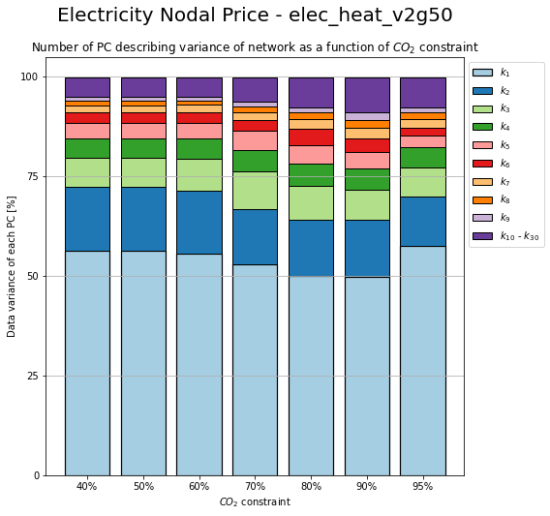
Change in PC due to CO2 Constrain

Slide 25
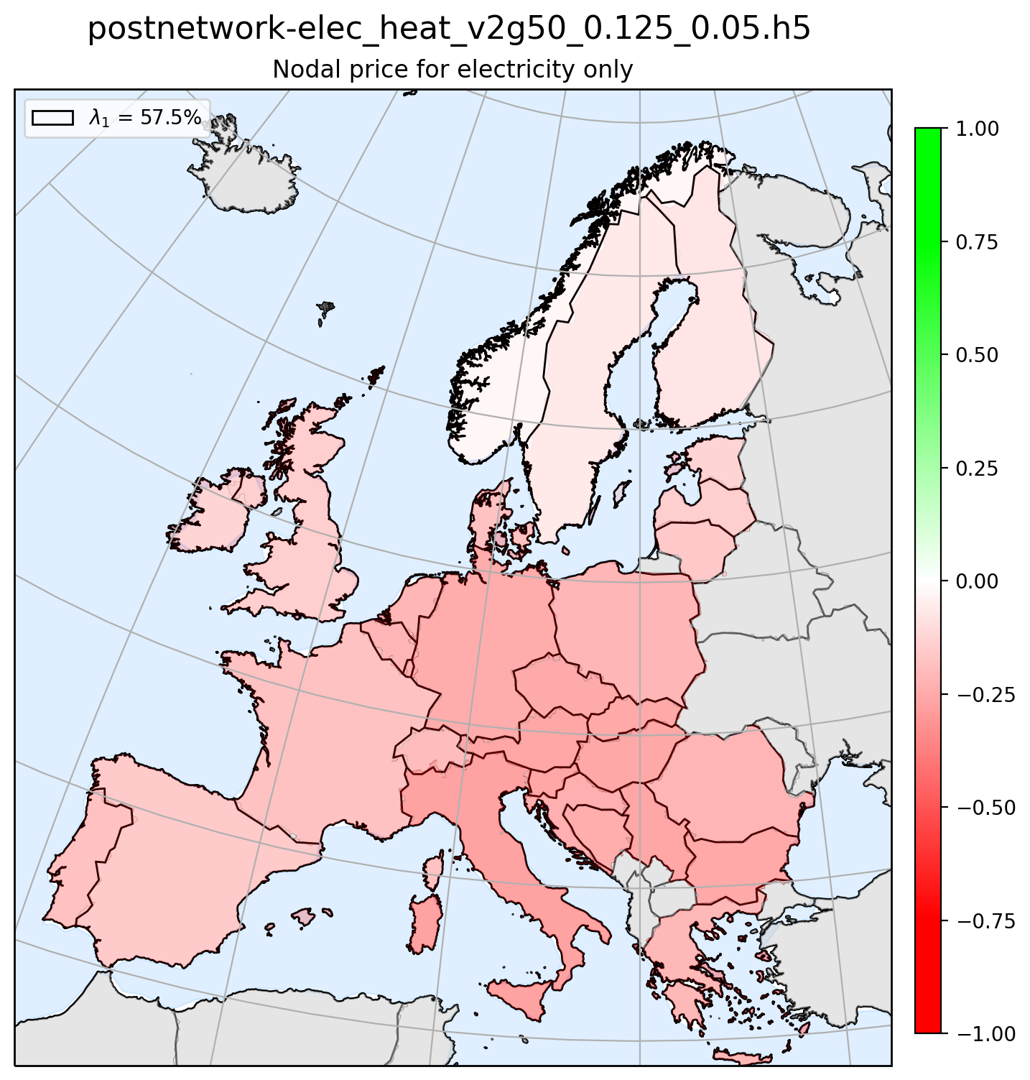
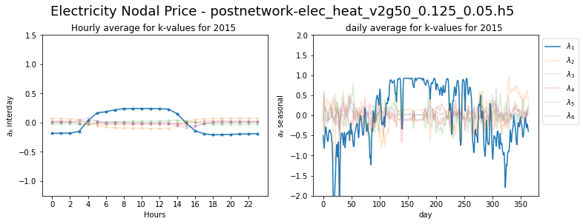
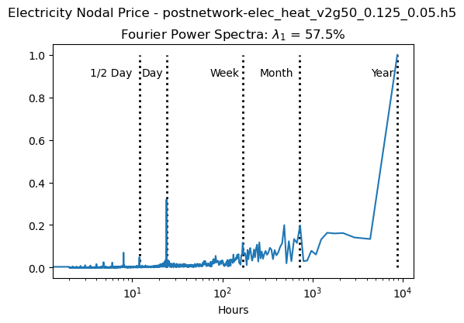
Principle Component 1

Slide 26
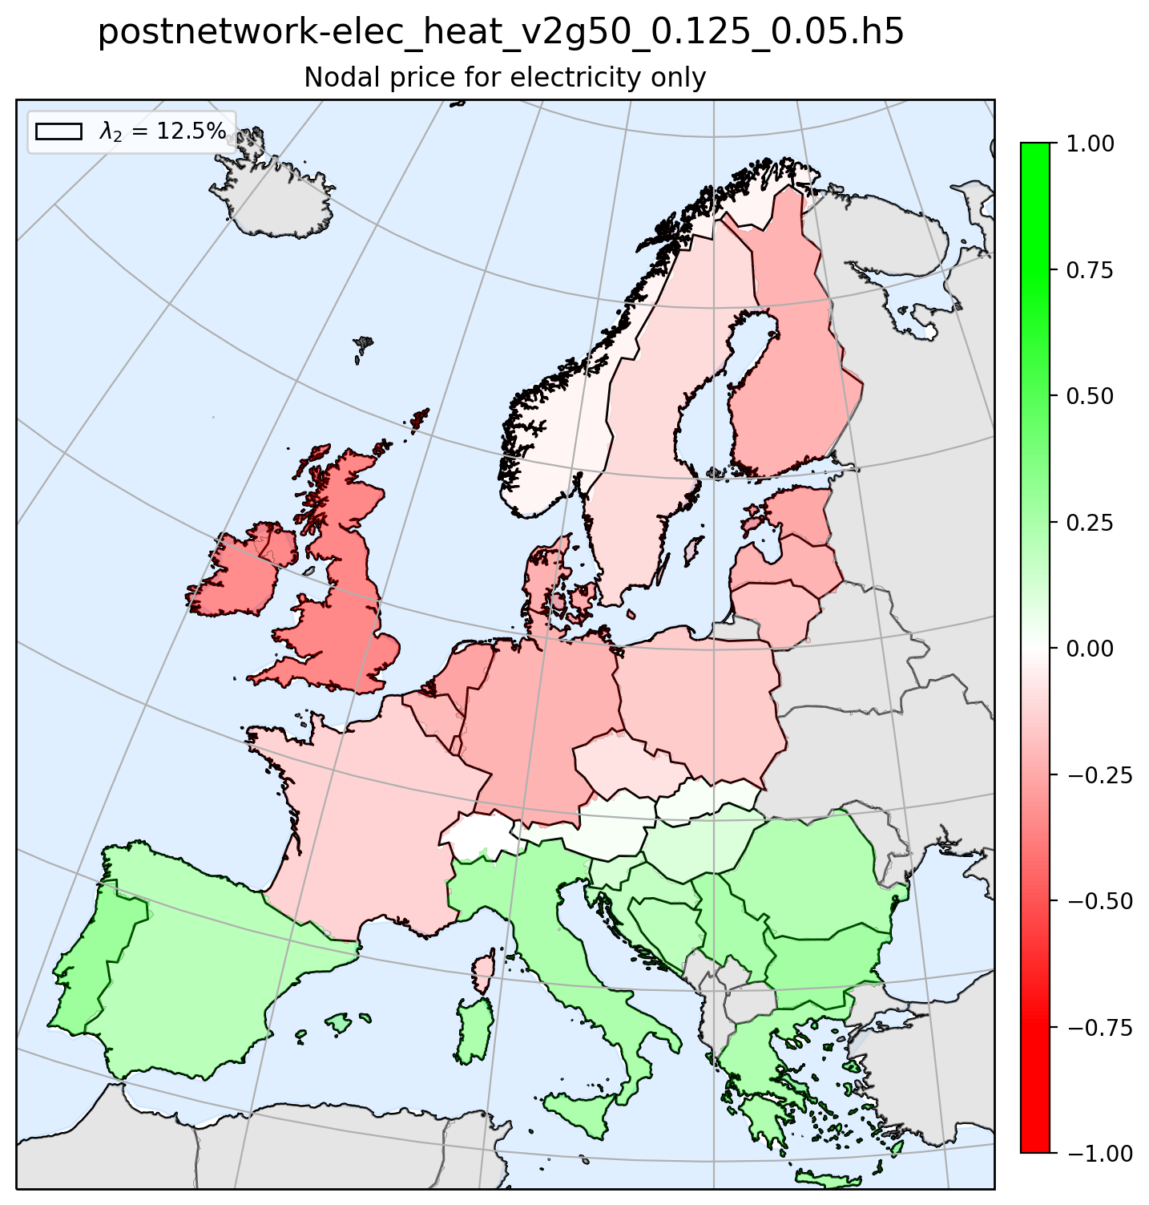
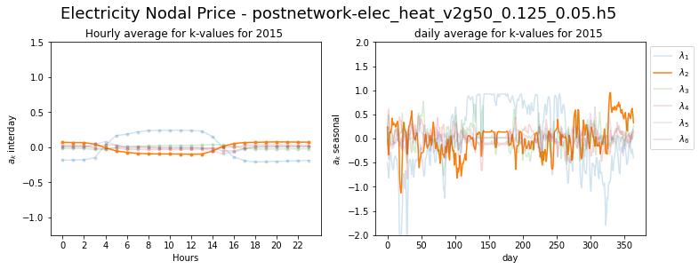
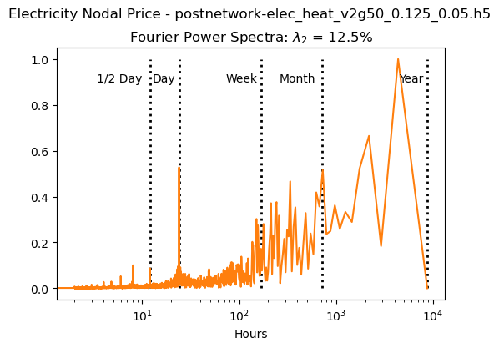
Principle Component 2

Slide 27
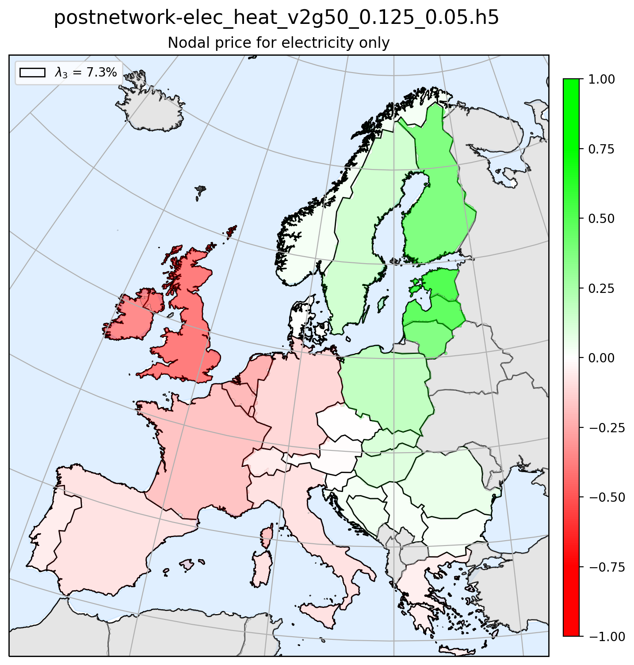
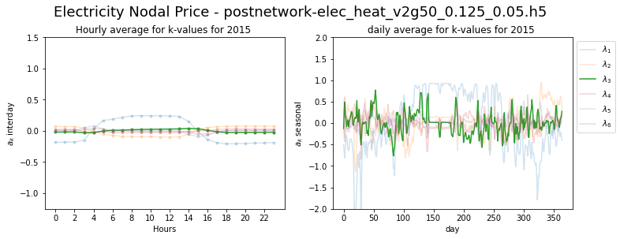
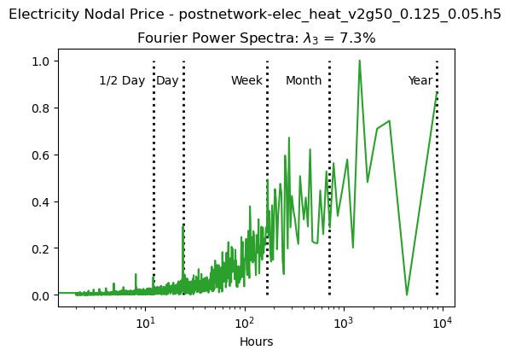
Principle Component 3

Slide 28
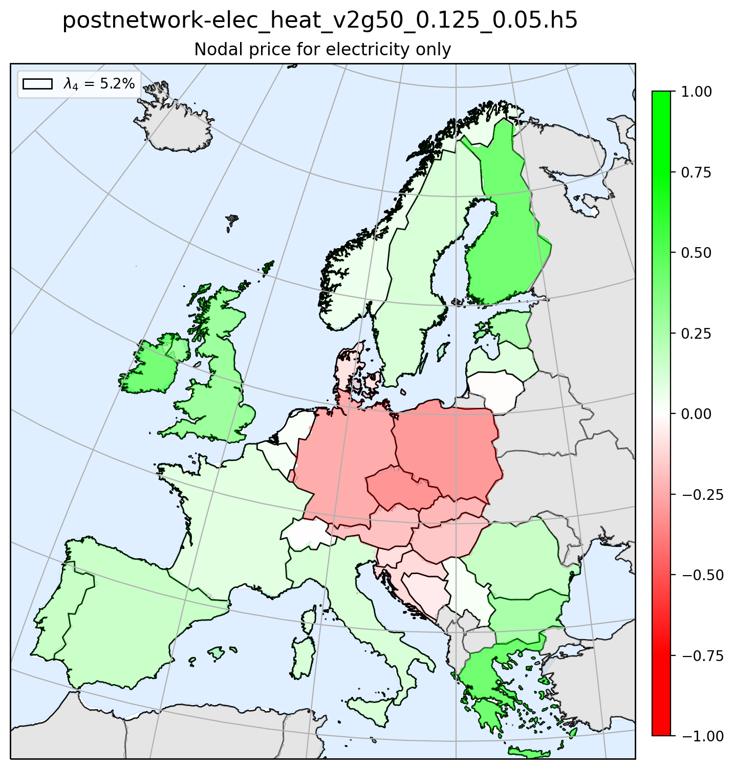


Principle Component 4

Slide 29



Principle Component 5

Slide 30



Principle Component 6

Slide 31
Electricity Coupled with the Heating and Transport Sector
Electricy Mismatch and NP Coherence

Slide 32

Coherence Method 1
Nodal Price
Mismatch
1)
2)
1)
2)
3)
4)
3)
4)
5)
6)
5)
6)

Slide 33

Coherence Method 2
Nodal Price
Mismatch
1)
2)
1)
2)
3)
4)
3)
4)
5)
6)
5)
6)

Slide 34

Coherence Method 3
Nodal Price
Mismatch
1)
2)
1)
2)
3)
4)
3)
4)
5)
6)
5)
6)

Slide 35
Electricity Coupled with the Heating and Transport Sector
Heating Mismatch Analysis

Slide 36

Installed capacity

Slide 37

Heating Supplied by Different Technologies

Slide 38

Installed storage (energy capacity)

Slide 39

Installed storage (power capacity)

Slide 40

Change in PC due to CO2 and Transmission Constrain

Slide 41




Principle Component 1

Slide 42




Principle Component 2

Slide 43




Principle Component 3

Slide 44




Principle Component 4

Slide 45




Principle Component 5

Slide 46




Principle Component 6

Slide 47

Change in Contribution due to CO2 and Transmission Constrain

Slide 48

Change in Reponse due to CO2 and Transmission Constrain

Slide 49

Change in Cov Reponse due to CO2 and Transmission Constrain

Slide 50

Change in Covariance due to CO2 Constrain

Slide 51
Electricity Coupled with the Heating and Transport Sector
Heating NP Analysis

Slide 52

Change in PC due to CO2 and Transmission Constrain

Slide 53



Principle Component 1

Slide 54



Principle Component 2

Slide 55



Principle Component 3

Slide 56



Principle Component 4

Slide 57



Principle Component 5

Slide 58



Principle Component 6

Slide 59
Electricity Coupled with the Heating and Transport Sector
Heating Mismatch and NP Coherence

Slide 60

Coherence Method 1
Nodal Price
Mismatch
1)
2)
1)
2)
3)
4)
3)
4)
5)
6)
5)
6)

Slide 61

Coherence Method 2
Nodal Price
Mismatch
1)
2)
1)
2)
3)
4)
3)
4)
5)
6)
5)
6)

Slide 62

Coherence Method 3
Nodal Price
Mismatch
1)
2)
1)
2)
3)
4)
3)
4)
5)
6)
5)
6)

Slide 63
Electricity Coupled with the Heating and Transport Sector
Transport Mismatch Analysis

Slide 64

Change in PC due to CO2 Constrain

Slide 65



Principle Component 1

Slide 66



Principle Component 2

Slide 67



Principle Component 3

Slide 68



Principle Component 4

Slide 69



Principle Component 5

Slide 70



Principle Component 6

Slide 71
Electricity Coupled with the Heating and Transport Sector
Transport NP Analysis

Slide 72

Change in PC due to CO2 Constrain

Slide 73



Principle Component 1

Slide 74



Principle Component 2

Slide 75



Principle Component 3

Slide 76



Principle Component 4

Slide 77



Principle Component 5

Slide 78



Principle Component 6

Slide 79
Electricity Coupled with the Heating and Transport Sector
Transport Mismatch and NP Coherence

Slide 80

Coherence Method 1
Nodal Price
Mismatch
1)
2)
1)
2)
3)
4)
3)
4)
5)
6)
5)
6)

Slide 81

Coherence Method 2
Nodal Price
Mismatch
1)
2)
1)
2)
3)
4)
3)
4)
5)
6)
5)
6)

Slide 82

Coherence Method 3
Nodal Price
Mismatch
1)
2)
1)
2)
3)
4)
3)
4)
5)
6)
5)
6)

Slide 83
Electricity Coupled with the Heating and Transport Sector
Electricity NP and Heating NP Coherence

Slide 84

Coherence Method 1
HNP
ENP
1)
2)
1)
2)
3)
4)
3)
4)
5)
6)
5)
6)

Slide 85

Coherence Method 2
HNP
ENP
1)
2)
1)
2)
3)
4)
3)
4)
5)
6)
5)
6)

Slide 86

Coherence Method 3
HNP
ENP
1)
2)
1)
2)
3)
4)
3)
4)
5)
6)
5)
6)

Slide 87
Electricity Coupled with the Heating and Transport Sector
Electricity NP and Transport NP Coherence

Slide 88

Coherence Method 1
TNP
ENP
1)
2)
1)
2)
3)
4)
3)
4)
5)
6)
5)
6)

Slide 89

Coherence Method 2
TNP
ENP
1)
2)
1)
2)
3)
4)
3)
4)
5)
6)
5)
6)

Slide 90

Coherence Method 3
TNP
ENP
1)
2)
1)
2)
3)
4)
3)
4)
5)
6)
5)
6)

Slide 91
Electricity Coupled with the Heating and Transport Sector
Heating NP and Transport NP Coherence

Slide 92

Coherence Method 1
TNP
HNP
1)
2)
1)
2)
3)
4)
3)
4)
5)
6)
5)
6)

Slide 93

Coherence Method 2
TNP
HNP
1)
2)
1)
2)
3)
4)
3)
4)
5)
6)
5)
6)

Slide 94

Coherence Method 3
TNP
HNP
1)
2)
1)
2)
3)
4)
3)
4)
5)
6)
5)
6)

